Slide 1
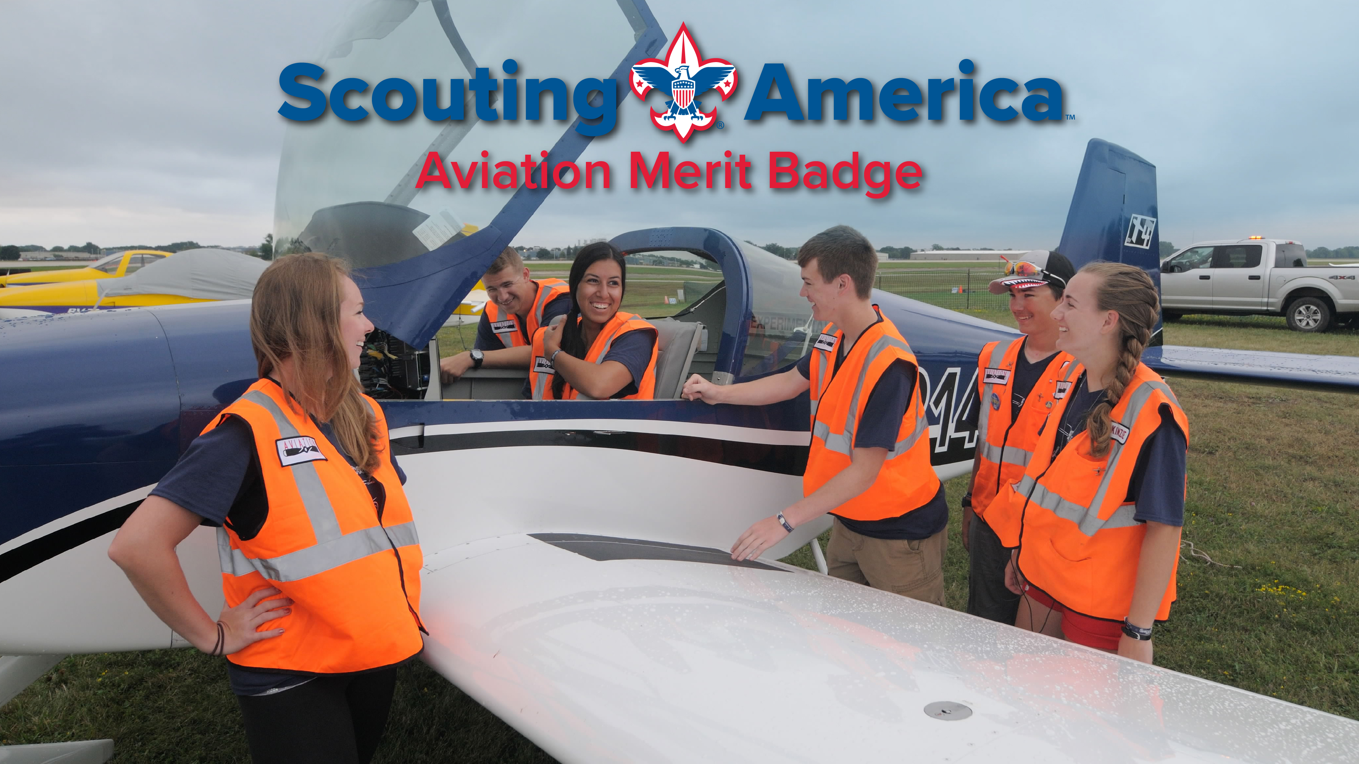
Counselor: Steve Jegier
Notes:
Welcome to Aviation Merit Badge! Individual counselor introduction and course-specific comments here. Encourage Scouts to check out the online Digital Resource Guide that has lots of information, in a fun, engaging, multi-media format!

Slide 2

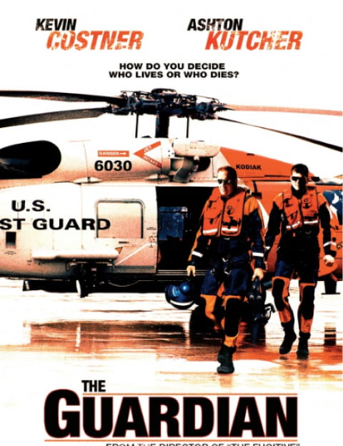

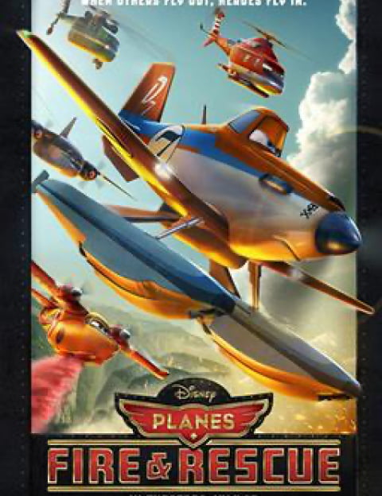
Aviation: In the movies
Some of the most famous movies have been about Aviation – with many based on real-life stories!
Notes:
While some of these may appear “larger than life,” it is important to know that most of these are based on real people doing real things – men and women who once were just like you!
Click the images to see the movie trailer.

Slide 3
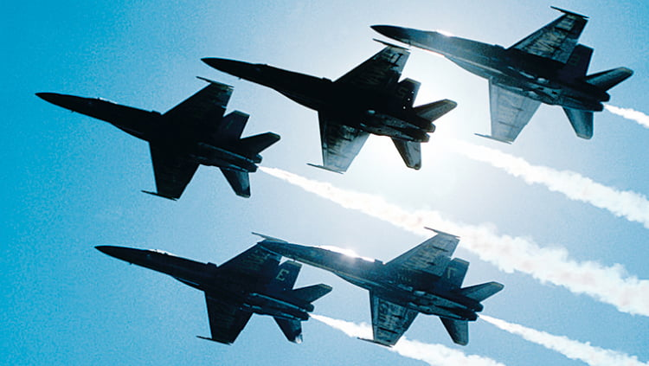
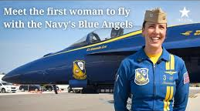
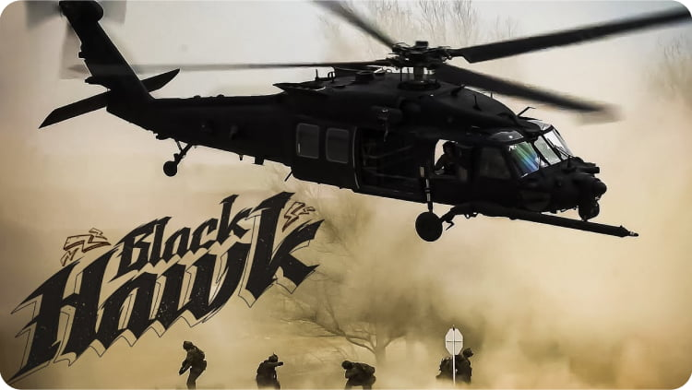
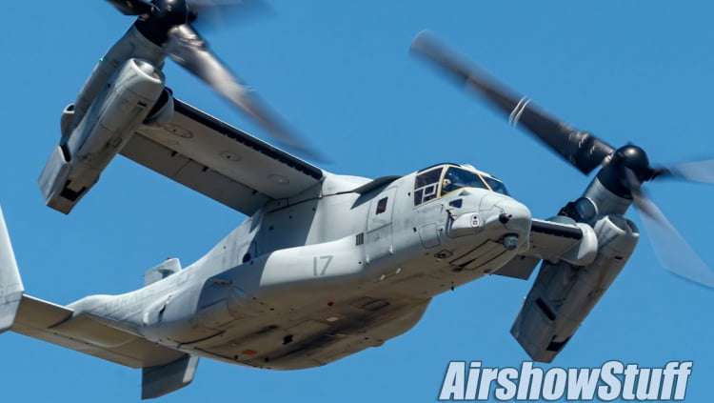
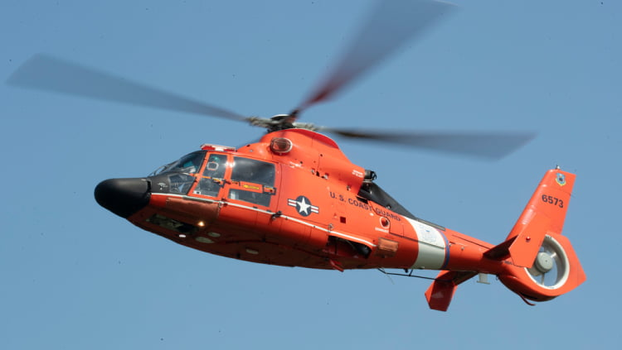
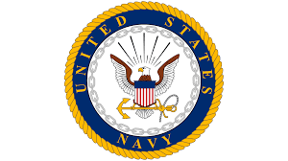


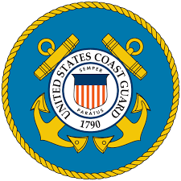

Aviation: In the military
Air Force
Navy
Army
Marines
Coast Guard
The Air Force provides air and space superiority, global strike capabilities, rapid mobility, intelligence, surveillance, and reconnaissance functions.
The Navy focuses on power projection from the sea, supporting fleet operations, and providing air superiority for carrier strike groups.
The US Army Tactical aviation group supports ground forces – including transport, reconnaissance, and attack operations.
The Marines use aviation to provide close air support for ground forces, expeditionary operations, and amphibious warfare.
The Coast Guard is focused on search and rescue (SAR), law enforcement, environmental protection, and maritime security.
Air Force Video
Navy Video
Army Video
Marines Video
Coast Guard Video
Notes:
Click on images to go to the IRL videos!
Here’s an overview of aviation roles and operations within all branches of the U.S. military, highlighting how each contributes uniquely to defense and other missions:
1. U.S. Air Force
Primary Mission: Air and space superiority, global strike, rapid mobility, intelligence, surveillance, and reconnaissance.
Aircraft Types:
Fighter Jets: F-22 Raptor, F-35 Lightning II, F-16 Fighting Falcon.
Bombers: B-52 Stratofortress, B-1 Lancer, B-2 Spirit.
Transport: C-17 Globemaster III, C-5 Galaxy, KC-135 Stratotanker (air refueling).
Reconnaissance and Drones: RQ-4 Global Hawk, MQ-9 Reaper.
Specialized Units:
Combat Search and Rescue (CSAR) with HH-60 Pave Hawk helicopters.
Space Operations through the U.S. Space Force (formerly part of the Air Force).
2. U.S. Navy
Primary Mission: Naval aviation focuses on power projection from the sea, supporting fleet operations, and providing air superiority for carrier strike groups.
Aircraft Types:
Carrier-Based Fighters: F/A-18 Hornet, F-35C Lightning II.
Maritime Patrol: P-8 Poseidon (anti-submarine warfare and reconnaissance).
Helicopters: MH-60R/S Seahawk (anti-submarine and transport).
Electronic Warfare: EA-18G Growler (jamming and radar suppression).
Unique Operations:
Aircraft carriers serve as mobile airbases, enabling worldwide deployment without relying on foreign bases.
Navy aviation supports amphibious assaults and naval blockades.
3. U.S. Army
Primary Mission: Tactical aviation support for ground forces, including transport, reconnaissance, and attack operations.
Aircraft Types:
Attack Helicopters: AH-64 Apache (close air support and anti-tank missions).
Transport Helicopters: UH-60 Black Hawk, CH-47 Chinook.
Reconnaissance: MQ-1C Gray Eagle drone and OH-58 Kiowa Warrior.
Fixed-Wing Aircraft: C-12 Huron and other light transport and reconnaissance planes.
Specialized Units:
The Army’s 160th Special Operations Aviation Regiment (SOAR), also known as the “Night Stalkers,” specializes in nighttime and low-level operations for special forces.
4. U.S. Marine Corps
Primary Mission: Close air support for ground forces, expeditionary operations, and amphibious warfare.
Aircraft Types:
Fixed-Wing Fighters: F-35B Lightning II (short takeoff/vertical landing) for close air support.
Rotary-Wing Aircraft: AH-1Z Viper (attack helicopter), CH-53E Super Stallion (heavy-lift transport).
Tiltrotor Aircraft: MV-22 Osprey (vertical takeoff and landing, troop and cargo transport).
Unique Role:
Marine Corps aviation focuses on integrated air-ground combat, supporting Marine ground forces during amphibious assaults and rapid deployment missions.
5. U.S. Coast Guard
Primary Mission: Search and rescue (SAR), law enforcement, environmental protection, and maritime security.
Aircraft Types:
Fixed-Wing Aircraft: HC-130J Super Hercules (long-range surveillance and transport).
Helicopters: MH-65 Dolphin, MH-60 Jayhawk (SAR and law enforcement).
Unmanned Aerial Systems: Drones used for reconnaissance and border patrol.
Specialized Missions:
Conducting drug interdiction, fisheries enforcement, and homeland security missions.
Responding to natural disasters and maritime emergencies.
How Scouts Can Learn More
Visit Military Bases or Aviation Facilities:
Many military installations host open house events or airshows where Scouts can see aircraft up close.
Request tours through Public Affairs Offices at local bases.
Participate in Youth Programs:
Programs like the Civil Air Patrol Cadet Program and Naval Sea Cadets offer aviation-related experiences for youth.
Junior Reserve Officers’ Training Corps (JROTC) often includes aviation education.
Attend Airshows or Museum Exhibits:
Visit military aviation museums (e.g., the National Museum of the U.S. Air Force, Naval Aviation Museum) to explore aircraft and learn about the branches.
ideos!

Slide 4
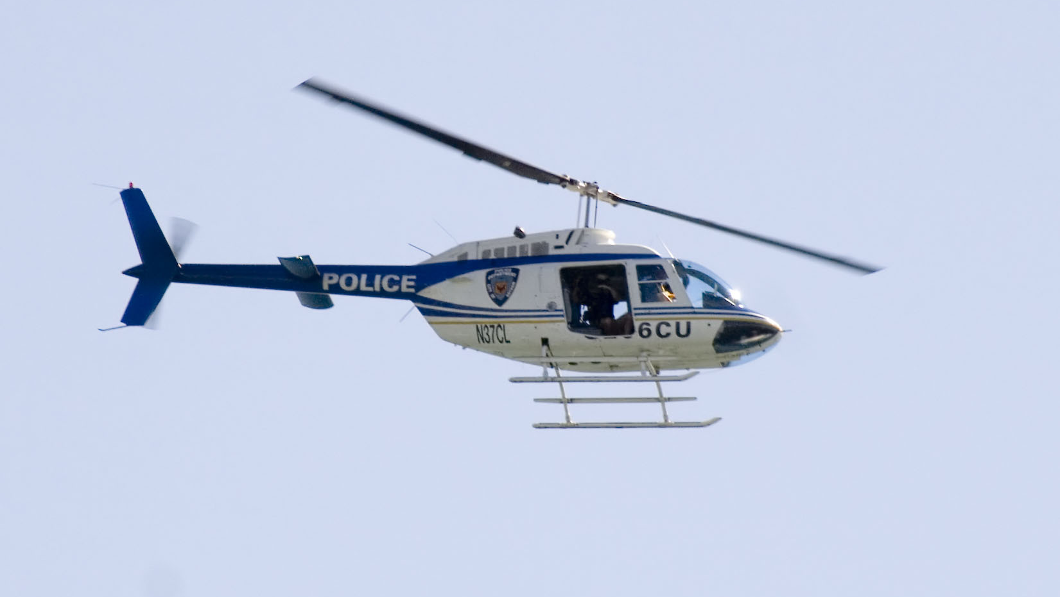
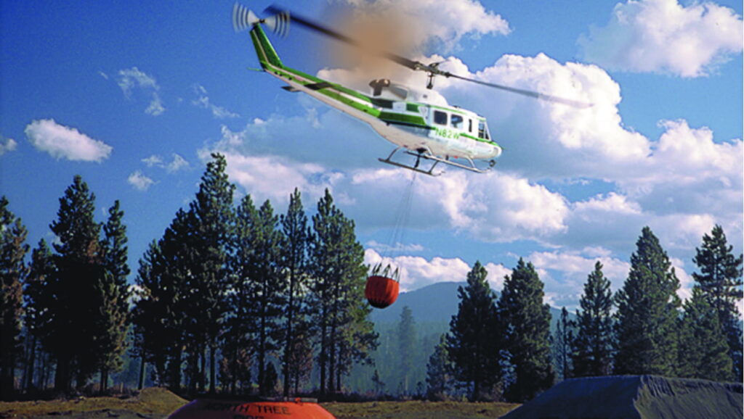
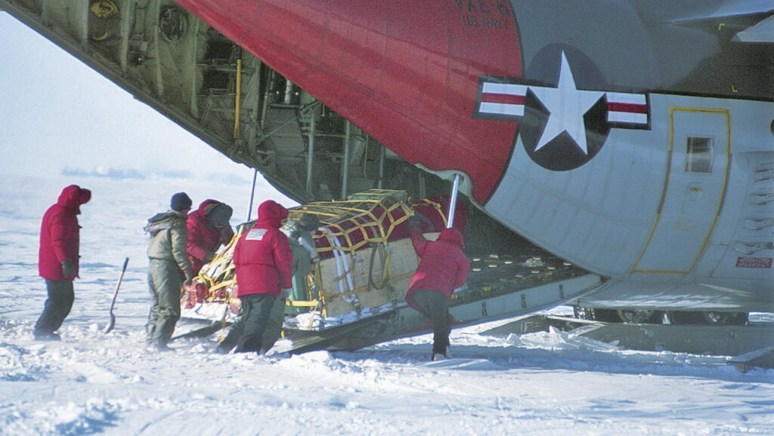
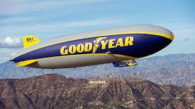
Aviation: In your life
Notes:
Click on images to go to the IRL videos!
The Impact of Aviation in Everyday Life
Aviation has transformed the way people live, work, and connect globally. It touches nearly every aspect of our daily lives, whether we realize it or not. Here’s a general overview of how aviation impacts everyday life. In addition to the military, aviation plays a vital role in the following:
1. Transportation and Connectivity
Global Travel:
Aviation allows people to travel quickly and efficiently across vast distances, shrinking the world and making international travel possible in hours instead of days or weeks.
It supports cultural exchange, tourism, and family connections, enabling people to explore new places and visit loved ones.
Business and Commerce:
Aviation enables businesses to operate on a global scale, facilitating face-to-face meetings, trade, and international collaboration.
It supports the mobility of professionals, allowing them to commute or relocate for work opportunities.
2. Economic Development
Employment:
Aviation supports millions of jobs worldwide, including pilots, air traffic controllers, airport staff, mechanics, engineers, and airline personnel.
Indirectly, it creates jobs in tourism, hospitality, logistics, and manufacturing industries.
Global Trade:
Air cargo transports high-value, time-sensitive goods like electronics, medical supplies, and perishable foods, sustaining global supply chains.
This ensures consumers have access to goods from around the world, such as fresh produce, pharmaceuticals, and luxury products.
3. Emergency Services and Humanitarian Aid
Disaster Response:
Aviation plays a crucial role in delivering aid to disaster-stricken areas, including food, water, and medical supplies.
Helicopters and cargo planes can access remote or otherwise unreachable regions quickly in emergencies.
Medical Transport:
Air ambulances and helicopters save lives by transporting patients to hospitals quickly, especially in rural or remote areas.
Organ transplants, vaccines, and critical medications are often transported by air to meet urgent medical needs.
4. Technological Advancements
Aviation drives innovation in materials, engineering, and safety systems, which often benefit other industries, including automotive and consumer electronics.
The development of efficient engines and navigation systems has improved fuel efficiency and environmental impact.
5. Environmental Awareness
The aviation industry is actively working toward sustainability through:
Development of fuel-efficient aircraft.
Use of sustainable aviation fuels (SAF).
Research into electric and hydrogen-powered aircraft.
Aviation also plays a role in monitoring the environment, using aircraft for weather research, climate studies, and wildlife management.
6. Cultural Exchange and Tourism
Aviation makes cultural exchange more accessible by allowing people to experience different countries, traditions, and cuisines.
It supports tourism, which is a major economic driver for many countries, fostering global understanding and appreciation.
7. Everyday Convenience
Mail and Parcel Delivery:
Air cargo ensures that packages, including e-commerce orders, arrive quickly, supporting modern consumer expectations.
Companies like FedEx, UPS, and Amazon rely on aviation for overnight and expedited shipping.
Commuter Flights:
Regional flights allow workers to commute between cities and even countries for business, expanding job opportunities.
Summary
Aviation plays a pivotal role in modern life, connecting people, goods, and services across the globe. It drives economic growth, fosters cultural understanding, supports emergency response, and improves overall quality of life. While challenges like environmental impact remain, ongoing innovation ensures that aviation will continue to shape the future in meaningful ways.

Slide 5
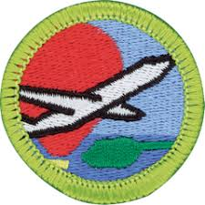
Aviation Merit Badge: Requirements
Aviation Basics & Mechanics of Flight
Principles of Flight
Flight Operations
Airport Operations
Personal & Professional Aviation Opportunities
Notes:
1. Aviation Basics and Mechanics of Flight. Do the following:
Define “aircraft”. Describe three kinds of aircraft today, and their typical uses.
Provide a brief overview of the evolution of flight, and discuss three notable times in history important to aviation.
Explain the difference between a fixed wing and a rotary wing aircraft, and the benefits of each.
Explain the operation of piston, turbine, and jet engines.
Using a model aircraft, describe the four forces that act on an aircraft in flight.
Explain how an airfoil generates lift, specifically noting Bernoulli’s principle.
Identify and describe the aerodynamic control surfaces on the aircraft of your choice, and explain how they operate to control its attitude and direction of flight.
Explain the purposes and functions of the various instruments found in a typical single-engine aircraft: attitude indicator, heading indicator, altimeter, airspeed indicator, turn and bank indicator, vertical speed indicator, compass, navigation, communication, and engine performance indicators.

Slide 6
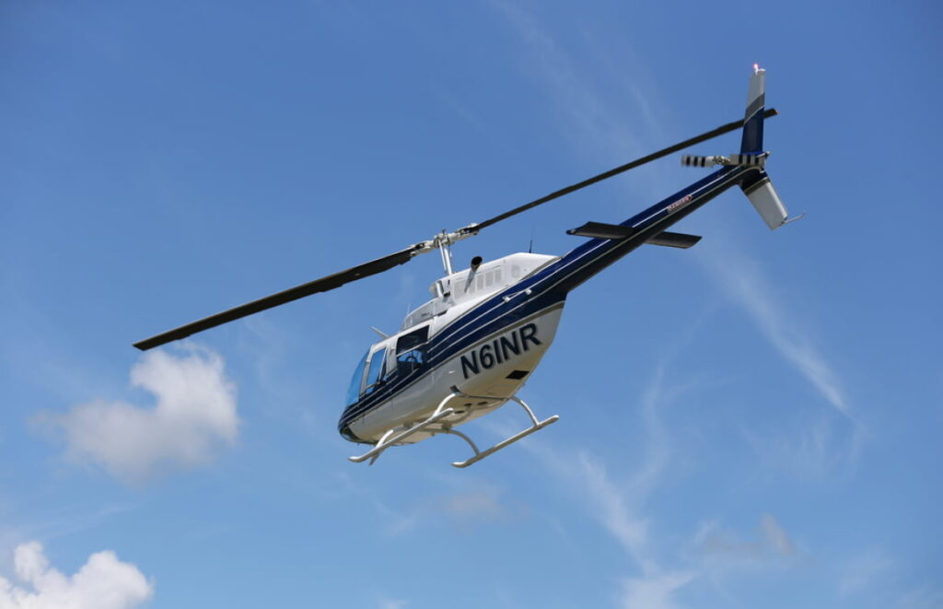
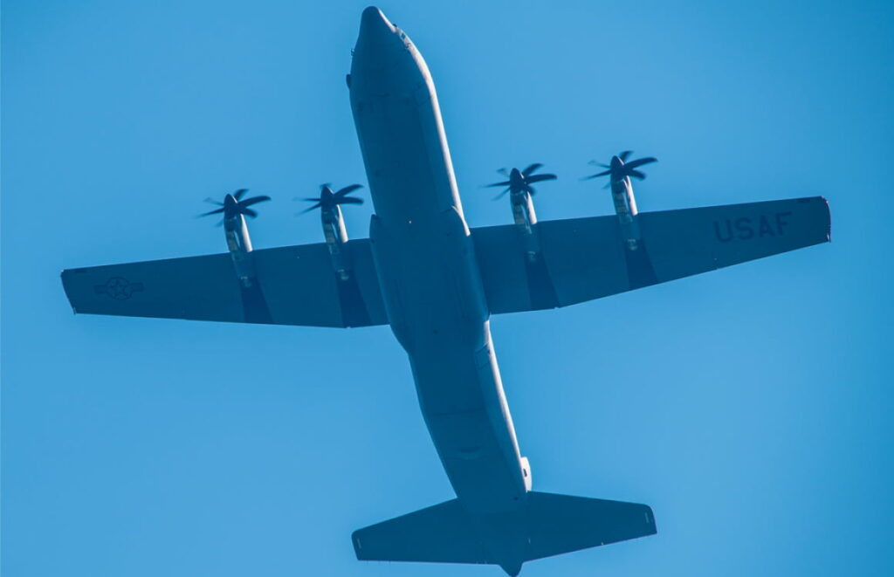
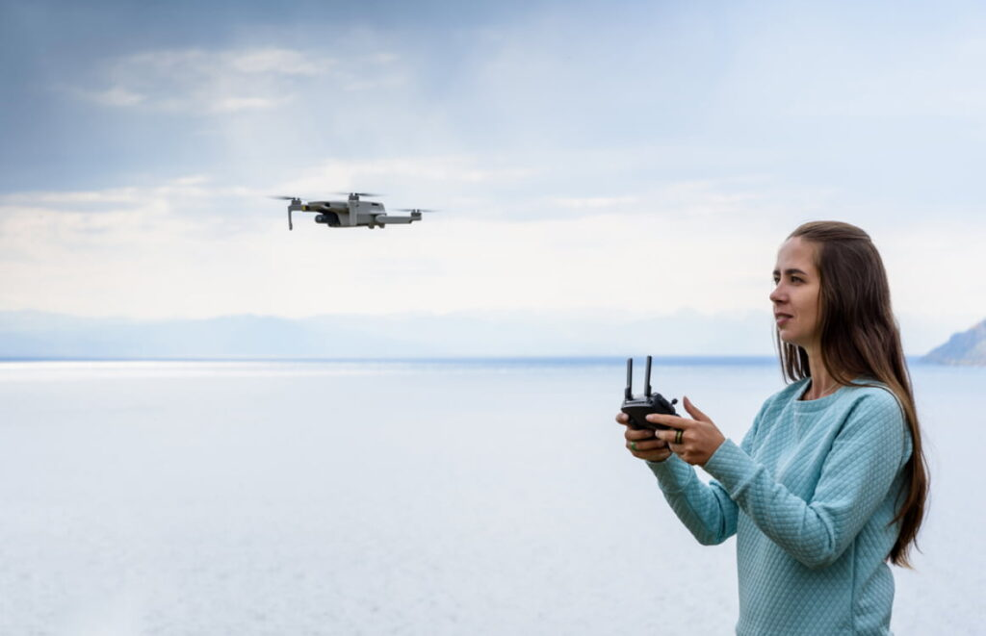
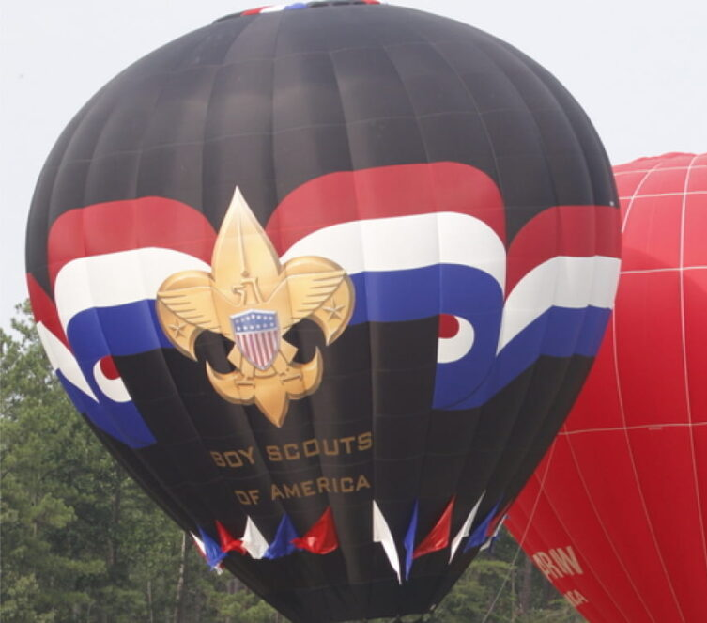
1. Aviation Basics & Mechanics of Flight
a. Define “Aircraft”
An aircraft is any vehicle that can fly in the air and be controlled by an operator. There are many different types of aircraft, including:
Airplanes: These are the most common type of aircraft. They have fixed wings and engines that push them through the air.
Helicopters: These have rotating blades (called rotors) that allow them to hover or fly up, down, and move in any direction.
Drones: These are unmanned, remote-controlled aircraft used for a variety of tasks like photography or carrying small items.
Hot air balloons: These use heated air to make the balloon float in the sky.
Notes:
An aircraft is defined as any vehicle that can fly in the air under the control of an operator (or “pilot”). It can be something big, like an airplane, or something smaller, like a drone. Aircraft use wings, engines, and/or rotors to lift off the ground and stay in the sky. Some aircraft, like helicopters, use spinning blades (called rotors) to lift, while airplanes use fixed wings and engines to generate the thrust needed for flying.
There are different types of aircraft, such as:
Airplanes: These are the most common type of aircraft. They have fixed wings and engines that push them through the air.
Helicopters: These have rotating blades (called rotors) that allow them to hover, fly up, down, and move in any direction.
Drones: These are smaller, often remote-controlled aircraft used for various tasks like photography or carrying small items.
Hot air balloons: These use heated air to make the balloon float in the sky.
So, an aircraft is anything that a pilot can fly, whether it’s for traveling, carrying cargo, or even for fun!

Slide 7
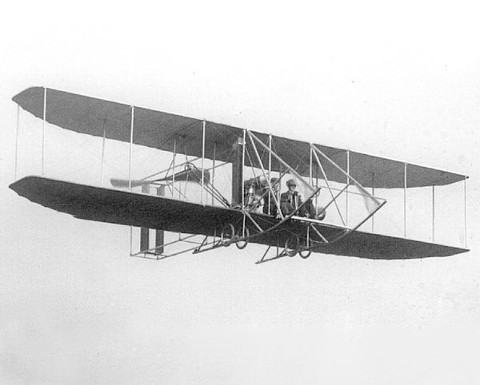
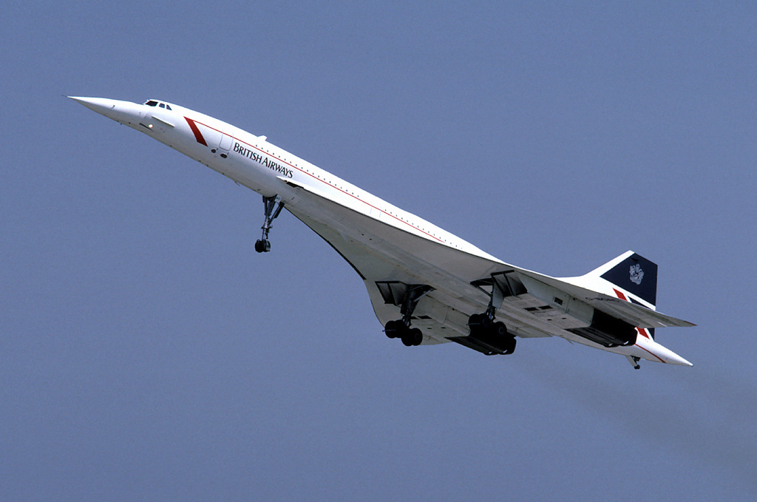
1. Aviation Basics & Mechanics of Flight
b. Provide a brief history on the evolution of flight, with three notable events
Aviation has developed rapidly over the past 150 years, including:
The Wright Brothers' First Flight (1903) - video
The First Flight Around the World – U.S. Army Air Service (1924) - video
First Solo Transatlantic Flight - Charles Lindbergh (1927) - video
First Solo Transatlantic Flight - Amelia Earhart (1932) - video
First Commercial Jet Airliner – de Havilland Comet (1949) - video
First Commercial Supersonic Flight - The Concorde (1969) – video
First Flight Around the World Without Refueling – Rutan Model 86 Voyager (1986) - video
FAA Approves Unmanned Aerial Vehicles (UAV’s aka Drones) (2006) - video
Notes:
These are some of the major events in aviation history that helped shape how we fly today:
1. The Wright Brothers' First Flight (1903)
Who: Orville and Wilbur Wright
What: On December 17, 1903, the Wright brothers made the first powered, controlled flight in Kitty Hawk, North Carolina. Their plane, the Flyer, flew for 12 seconds and covered 120 feet (about the length of a school bus).
Why It’s Important: This was the first time a heavier-than-air, powered aircraft flew under control, marking the start of modern aviation.
7. The First Flight Around the World (1924)
Who: U.S. Army Air Service
What: The first successful flight around the world was completed by four U.S. Army Air Service pilots in 1924. The flight lasted 175 days and covered about 26,000 miles.
Why It’s Important: This demonstrated the ability to fly long distances across the globe, which laid the groundwork for modern international flights.
3. Charles Lindbergh's Solo Transatlantic Flight (1927)
Who: Charles Lindbergh
What: In 1927, Lindbergh made the first solo nonstop transatlantic flight from New York to Paris, flying in the Spirit of St. Louis. The journey took 33.5 hours.
Why It’s Important: Lindbergh's flight proved that long-distance, nonstop air travel was possible and opened the door for commercial air travel across the Atlantic.
4. Amelia Earhart’s Solo Transatlantic Flight (1932)
Who: Amelia Earhart
What: In 1932, Amelia Earhart became the first woman to fly solo across the Atlantic Ocean, from Newfoundland to Ireland.
Why It’s Important: Earhart was a pioneer for women in aviation and showed that women could accomplish amazing feats in fields previously dominated by men.
5. The First Commercial Jet Airliner (1949)
Who: The British
What: The de Havilland Comet, the world’s first commercial jet airliner, made its first flight in 1949. It was faster and could carry more passengers than the propeller-driven planes that came before it.
Why It’s Important: This marked the beginning of the jet age and paved the way for modern commercial air travel, making flying faster and more accessible.
6. The Concorde’s First Supersonic Flight (1969)
Who: British and French engineers
What: The Concorde, a supersonic passenger jet, first flew in 1969 and started commercial flights in 1976. It could fly faster than the speed of sound, reaching speeds of over 1,350 mph (Mach 2).
Why It’s Important: The Concorde revolutionized air travel by cutting flight times in half (e.g., New York to London in 3.5 hours), though it was retired in 2003 due to high operating costs and other issues.
7. First Flight Around the World Without Refueling)
Who: Dick Rutan & Andrea Yeager
What: The Model 86 Voyager, a highly fuel-efficient plane with an ultralight structure and very long wingspan
Why It’s Important: Helped identify and prove out a number of fuel-efficient technologies that are used in aerospace engineering today
8. The Rise of UAV’s (Drones) (2006-present)
Who: The FAA’s decision to approve UAV’s, then various companies and organizations
What: Drones (unmanned aerial vehicles, or UAVs) began to be used for military, commercial, and recreational purposes. They’re often used for surveillance, delivering packages, and aerial photography.
Why It’s Important: Drones are shaping the future of aviation by making it possible to perform tasks without a pilot on board, and they’re likely to play a big role in the future of delivery services and even passenger flights.
These events are just a few examples, but they show how aviation has advanced from simple flights to reaching the moon and flying across the world. Each of these milestones helped push the boundaries of what was possible in air and space travel!

Slide 8
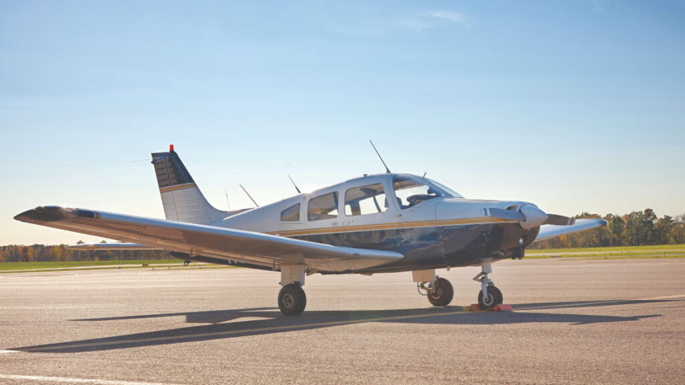
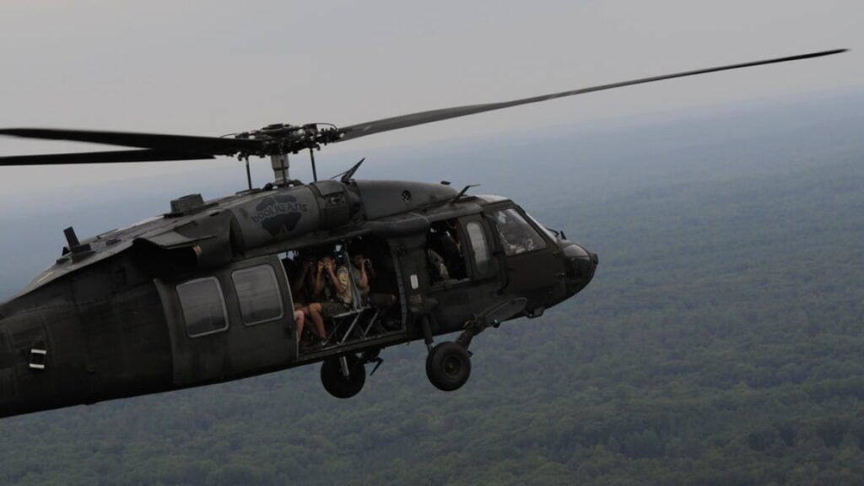
1. Aviation Basics & Mechanics of Flight
c. Explain the difference between Fixed Wing v. Rotary Wing Aircraft, and benefits of each.
Video
Fixed Wing Highlights
Create thrust through rotating propeller(s), and lift through fixed wings
Higher top speeds than rotary aircraft
Require long runways to take off/land
Rotary Wing Highlights
Utilize rotating blades (rotors) that spin to create lift and thrust
Can take off/land vertically, and hover in place
Lower top speeds than fixed wing aircraft
Notes:
Here's an easy way to understand the difference between fixed-wing and rotary-wing aircraft:
Fixed-Wing Aircraft
Definition: These are the types of aircraft that have stationary wings. The wings are attached to the main body (fuselage) of the aircraft and do not move.
How They Fly: Fixed-wing aircraft rely on the forward motion of the aircraft to generate lift. The engines (often jet engines or propellers) push the plane forward, and the wings create upward force as air flows over and under them. The faster the plane moves, the more lift is generated.
Examples: Airplanes (like the Boeing 747, Cessna 172, or military fighter jets).
Advantages: They’re generally faster and more efficient for long-distance travel. They can carry more passengers or cargo.
Disadvantages: Fixed-wing aircraft need a runway to take off and land, so they can’t hover or land vertically.
Rotary-Wing Aircraft
Definition: These aircraft have rotating blades (called rotors) instead of fixed wings. The rotor blades spin around a central hub, generating lift and thrust.
How They Fly: The rotor blades create lift by spinning rapidly through the air. This allows rotary-wing aircraft to hover in place, fly vertically, or move in any direction (up, down, forward, backward, side-to-side). The main rotor provides lift, while a tail rotor often helps control the direction of the aircraft.
Examples: Helicopters (like the Sikorsky UH-60 Black Hawk or Bell 206 JetRanger).
Advantages: They can hover in place and can take off and land vertically, meaning they don’t need a runway. This makes them useful for rescue missions, military operations, and places where a runway isn't available.
Disadvantages: They are usually slower and less fuel-efficient than fixed-wing aircraft. They also have more moving parts, which can increase maintenance.
Key Differences:
Wings vs. Rotors: Fixed-wing aircraft use non-moving wings for lift, while rotary-wing aircraft use rotating blades (rotors).
Takeoff/ Landing: Fixed-wing aircraft need a runway to take off and land, while rotary-wing aircraft can take off and land vertically (no runway needed).
Speed & Efficiency: Fixed-wing aircraft are generally faster and more fuel-efficient over long distances. Rotary-wing aircraft are more maneuverable but are usually slower and less efficient.
Quick Summary:
Fixed-Wing: Wings that don't move; needs a runway; faster for long distances.
Rotary-Wing: Rotors that spin; can hover and land anywhere; slower but more maneuverable.
Both types of aircraft have their own strengths and are used for different purposes depending on what’s needed for the mission!

Slide 9
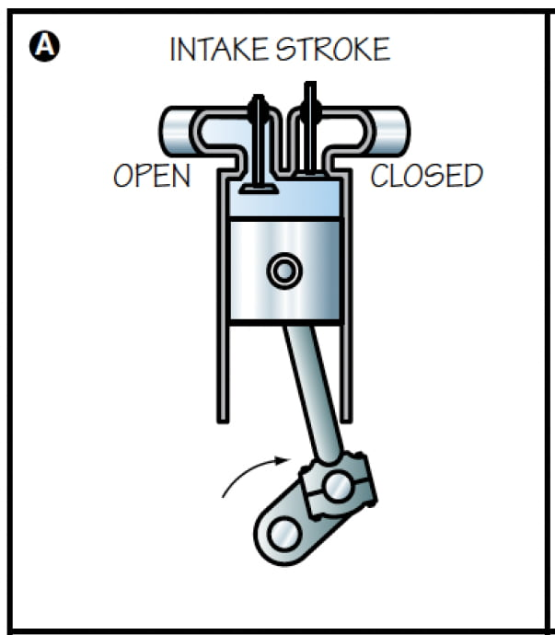
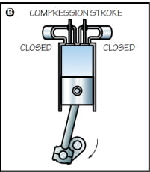
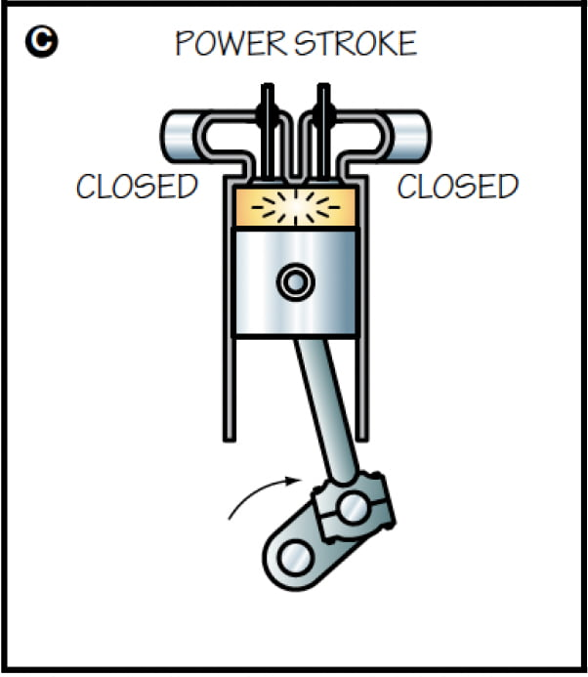
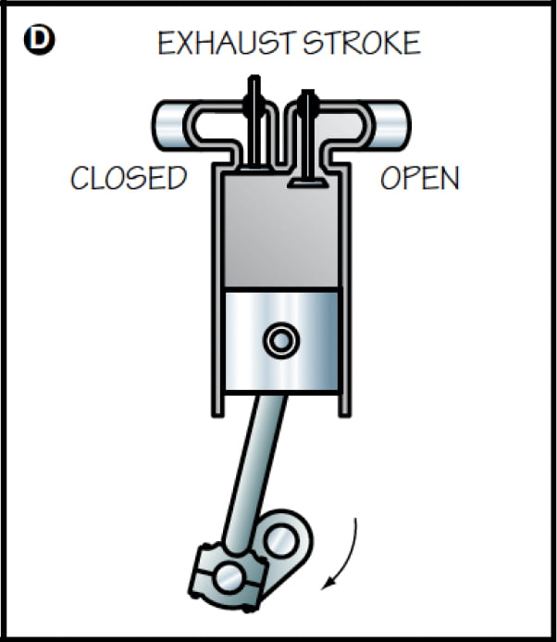
1. Aviation Basics & Mechanics of Flight
d. Explain the operation of PISTON, turbine, and jet engines
Video
Notes:
An internal combustion engine (like the one in most cars) is a machine that turns fuel (like gas) into power to make the car move. Here's how it works:
1. Fuel Goes In
First, the engine takes in a mix of air and fuel (like gasoline) through a valve. This happens when you press the gas pedal.
2. Compression
The engine has pistons that move up and down inside metal tubes called cylinders. Once the fuel-air mixture is inside the cylinder, the piston moves up and squeezes (compresses) the mixture, making it really dense and ready to explode.
3. Ignition (The Spark)
Next, the engine has a spark plug. This spark plug creates a tiny spark, which lights the compressed fuel and air. When the fuel explodes, it creates a lot of pressure.
4. Power Stroke
This explosion pushes the piston down really fast. This is where the engine gets its power to turn the wheels of the car.
5. Exhaust
After the piston is pushed down, the engine needs to get rid of the leftover gases from the explosion. Another valve opens, and the piston moves back up to push the exhaust gases out.
6. Repeat
The engine keeps repeating this cycle—sucking in fuel and air, compressing it, exploding it, and then pushing out the exhaust—over and over again very fast. This is what keeps the car moving!
In short:
The engine burns fuel inside cylinders to make tiny explosions. These explosions push pistons that turn the car's wheels. It's like a series of mini "booms" happening really quickly to keep the car going.
Does that make sense?

Slide 10
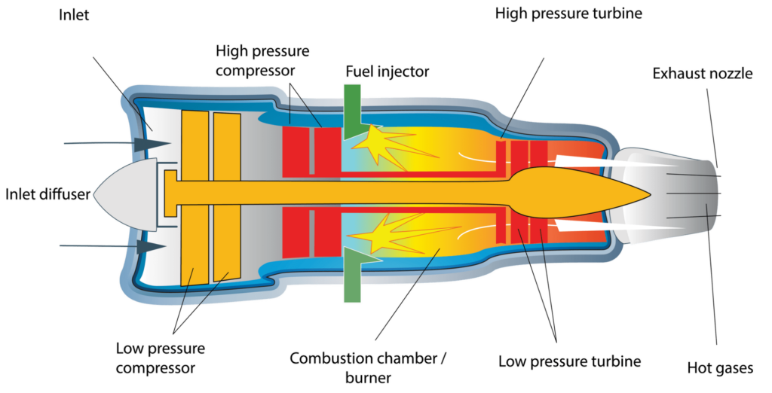
1. Aviation Basics & Mechanics of Flight
d. Explain the operation of piston, TURBINE, and jet engines
Video
Notes:
Now, let's talk about turbine engines, like the ones used in airplanes. A turbine engine works a bit differently from an internal combustion engine, but it still uses the same basic idea—turning energy into power to make things move.
Here's how it works in simple steps:
1. Air Intake
First, the engine pulls in a huge amount of air through the front. This happens because the plane is moving fast through the sky, so air is forced into the engine.
2. Compression
Once the air is inside the engine, it passes through a series of spinning fans or compressors. These fans squeeze (compress) the air, making it very dense and ready for the next step.
3. Mixing with Fuel
After the air is compressed, it moves into a section of the engine where fuel (usually jet fuel) is injected into the compressed air. The air and fuel mix together and are ready to be ignited.
4. Ignition and Combustion
In the combustion chamber, the fuel and compressed air are ignited by spark plugs. When the fuel burns, it creates a lot of hot, high-pressure gas. This is the key part that makes the engine work—this hot gas expands very quickly and creates a lot of energy.
5. Turbine (Turning the Power Into Motion)
The high-pressure gas moves through a set of turbines. A turbine is like a giant fan that spins when the hot gas hits it. The spinning turbine is connected to the compressors at the front of the engine, so as it spins, it helps drive the compressors that keep pulling in more air. It's like a cycle where energy from the hot gas keeps things moving.
6. Exhaust
After the gas passes through the turbines, it is forced out of the back of the engine at very high speed through a nozzle. This fast-moving exhaust is what creates thrust—the force that pushes the plane forward. The faster the air is pushed out, the faster the plane goes.
7. Repeat
The whole process happens over and over again as long as the engine is running, pulling in air, mixing it with fuel, burning it to create hot gas, and using that gas to spin the turbines and produce thrust.
In short:
A turbine engine takes in air, compresses it, mixes it with fuel, burns it to make hot gas, and then uses that gas to spin turbines. The turbines create thrust by pushing air out the back of the engine, making the plane move forward.
So, it's like a continuous cycle of sucking in air, burning fuel, and turning that into a fast-moving exhaust to push the airplane forward.
Pretty cool, right?

Slide 11
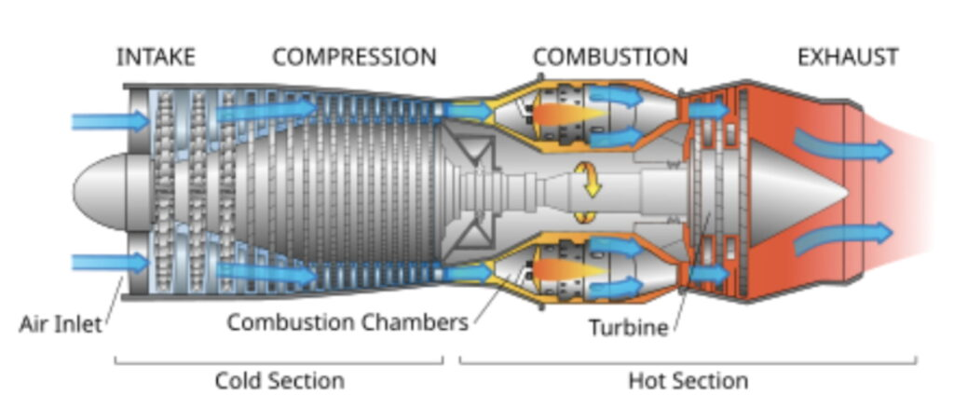
1. Aviation Basics & Mechanics of Flight
d. Explain the operation of piston, turbine, and JET engines
Video
Notes:
Actually, a jet engine is really just a specific type of turbine engine—specifically, the kind used in airplanes to create the thrust that makes them fly. So the explanation I gave for a turbine engine applies to most jet engines as well.
But let’s break it down a little more and see what makes a jet engine special.
1. Air Intake
A jet engine starts by pulling in a large amount of air through the front of the engine. This air is sucked in because the airplane is moving so fast through the sky. If you imagine the airplane is like a giant vacuum cleaner, it’s constantly pulling in air.
2. Compression
Once the air is inside, it passes through a series of compressor blades. These are fast-spinning fans that squish the air, making it much denser. The air is now packed with more oxygen, which is important for combustion (the burning part).
3. Mixing with Fuel
Now, the compressed air moves into the combustion chamber (this is where the "burning" happens). Here, fuel (like jet fuel) is injected into the high-pressure air. This mix of compressed air and fuel is ready to be ignited.
4. Ignition and Combustion
In the combustion chamber, the air-fuel mixture is lit on fire by spark plugs or sometimes by heat from the engine itself. When the fuel burns, it creates a lot of heat and high-pressure gas. The burning process makes the air expand really fast—this is a powerful release of energy.
5. Turbine
This hot, high-pressure gas moves through a series of turbines. The turbines are special blades that spin when the hot gas hits them. The spinning turbines are connected to the front compressors, so as they turn, they help keep pulling in more air into the engine.
6. Exhaust and Thrust
Finally, after the gas passes through the turbines, it moves into the exhaust nozzle at the back of the engine. The gas is forced out at incredibly high speed. This high-speed exhaust creates thrust, which is the pushing force that propels the airplane forward.
7. Repeat
The process keeps repeating. The engine continues to suck in air, compress it, mix it with fuel, burn it, spin the turbines, and blast out hot gas to keep the airplane moving.
Key Point About Jet Engines:
Jet engines, whether they are turbofan engines, turbojet engines, or turbo prop engines, all work on this basic idea of using hot, high-pressure gas to spin turbines and create thrust.
A turbofan engine (the kind most commercial planes use) has an extra set of fans at the front of the engine that push even more air around the engine to create even more thrust. These fans make it quieter and more efficient.
In short:
A jet engine is a type of turbine engine that uses fast-moving, compressed air, mixes it with fuel, burns it, and turns that energy into thrust by pushing out hot gases at the back. That thrust is what pushes the plane forward, letting it fly.
Think of it like a huge air pump that sucks in air, burns it to make an explosion, and then blasts the air out the back to send the plane zooming through the sky. Pretty amazing!

Slide 12
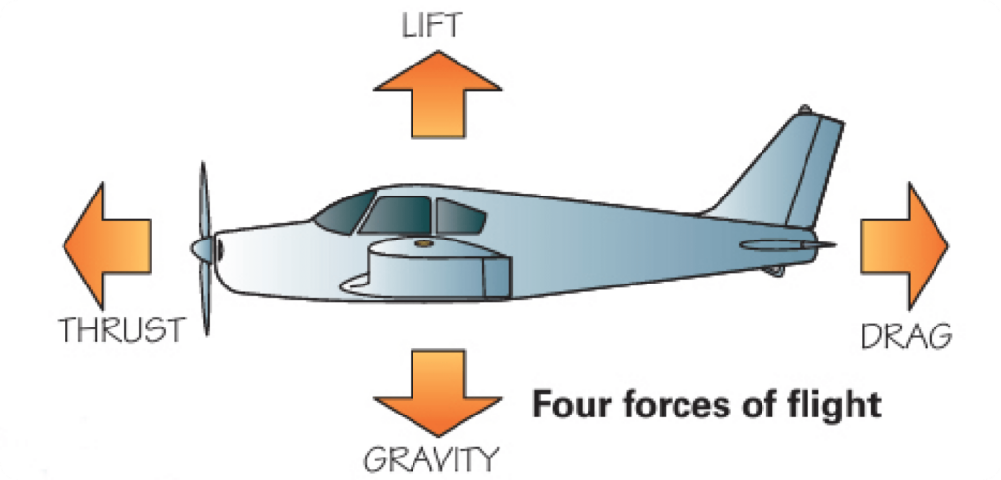
1. Aviation Basics & Mechanics of Flight
e. Describe the four forces that act on an aircraft in flight
Keeps the plane in the air
Slows the plane down
Video
Pulls the plane forward
Weight of the aircraft
Notes:
Now, let’s dive into the four forces that act on an aircraft in flight. These forces are what keep the airplane in the air, make it move, and control its flight. Here they are:
1. Lift
What it is: Lift is the force that pushes the airplane up.
How it works: Lift is generated by the wings of the airplane. The shape of the wings (called an airfoil) is designed so that air moves faster over the top of the wing and slower underneath it. This creates a pressure difference—lower pressure on top of the wing and higher pressure underneath. This difference in pressure lifts the airplane into the sky, fighting gravity.
Think of it like this: When air moves faster over the top of the wing, it’s like the wing is "sucking" the airplane upward!
2. Weight (Gravity)
What it is: Weight is the force that pulls the airplane down toward the Earth.
How it works: Weight is the force of gravity acting on the airplane's mass. The bigger the airplane (or the more stuff it carries), the greater its weight. To keep the plane flying, lift needs to be equal to or greater than the weight of the airplane. If the plane’s weight is too much for the lift, it will fall to the ground.
Think of it like this: Gravity is always trying to pull the airplane down to the Earth, but lift is fighting to keep it up!
3. Thrust
What it is: Thrust is the force that pushes the airplane forward.
How it works: Thrust is created by the engines (whether that’s a jet engine, turbofan, or propeller engine). The engines push the airplane forward by expelling air (or gas) at high speed out the back. Just like a rocket, the action of pushing air out the back creates an opposite reaction—pushing the airplane forward.
Think of it like this: If you've ever blown air out of a balloon and watched it fly around the room, the engine is doing something similar—using fast-moving exhaust to push the plane forward.
4. Drag
What it is: Drag is the force that pushes the airplane backwards and slows it down.
How it works: Drag is like air resistance. As the airplane moves through the air, the air pushes against it, trying to slow it down. The faster the airplane goes, the more drag there is. Airplanes are designed to be streamlined (with smooth shapes) to reduce drag, but it’s always there. Drag acts opposite to the direction of thrust.
Think of it like this: Drag is like trying to run through water—it's harder to move, right? The faster the plane goes, the more drag it faces, and that’s why the engines have to work hard to overcome it.
Equilibrium. So, what happens when these forces are balanced – or, “in equilibrium”?
Lift and weight are vertical forces, and thrust and drag are horizontal forces.
When the airplane is cruising, these forces are in balance: Lift equals weight, and thrust equals drag. This allows the airplane to fly steadily at a constant altitude and speed.
When the pilot wants to climb or descend, they adjust the throttle (thrust) or pitch the plane to change the balance of forces.
In short:
Lift pushes the plane up (created by the wings).
Weight (gravity) pulls the plane down.
Thrust pushes the plane forward (created by the engines).
Drag slows the plane down (resistance from the air).
To fly smoothly, a pilot has to manage and balance all these forces! It’s like a tug-of-war between them all.

Slide 13
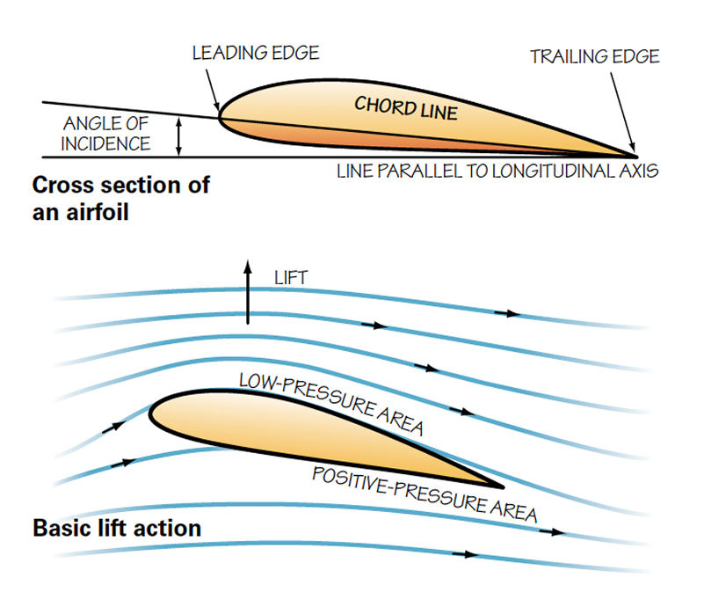
1. Aviation Basics & Mechanics of Flight
f. Explain how an airfoil generates lift, specifically noting Bernoulli’s Principle.
Video
Notes:
Now, let's dive into how an airfoil (the shape of an airplane's wing) generates lift, and we'll touch on Bernoulli’s Principle because it plays a big role in this.
What is an Airfoil?
An airfoil is the shape of a wing, or any surface designed to produce lift. It has a curved top surface and a flatter bottom surface. This shape is crucial for creating the pressure differences that allow the airplane to fly.
How an Airfoil Generates Lift:
The key to understanding how an airfoil generates lift lies in the difference in air pressure above and below the wing. Here’s how it works, step by step:
1. Air Moves Faster Over the Top
As air flows over the wing, it splits to go over the top and under the bottom. Because of the curved shape of the top of the wing, the air over the top has to travel a longer path than the air underneath. To stay in sync with the air flowing below the wing, the air on top speeds up to cover that extra distance.
2. Air Moves Slower Underneath
On the bottom of the wing, the surface is flatter, so the air doesn’t have to move as fast to keep up with the flow on top. This means the air beneath the wing is moving slower compared to the air above the wing.
Bernoulli’s Principle in Action
This is where Bernoulli’s Principle comes into play. Bernoulli’s Principle states that as the speed of a fluid (like air) increases, its pressure decreases, and as the speed of a fluid decreases, its pressure increases.
On top of the wing, where the air moves faster, the pressure is lower.
Under the wing, where the air moves slower, the pressure is higher.
This difference in pressure creates a lifting force. The higher pressure below the wing pushes the wing up toward the lower-pressure area above the wing, creating lift.
The Role of Angle of Attack
The angle of attack is the angle at which the wing meets the airflow. If the angle is too steep, the airflow over the top of the wing can become turbulent, reducing the lift (and possibly causing a stall). So, the angle of attack also plays a role in how effectively an airfoil generates lift.
The Role of Flaps and Slats
Flaps are extensions on the back of a wing that can be extended or retracted) can increase lift, and also add drag – very useful for take-off and landing.
Slats are sections on top of the wing that can be raised to reduce lift after the plane has landed.
Propellers are just rotating airfoils!
In fixed-wing, propeller driven aircraft, the propellers generate thrust though the multiple airfoils on each propeller. Variable-pitch propellers can increase the angle of attack on the blades, to change the efficiency in flight.
In rotary-wing aircraft, the propeller (and corresponding rotating airfoils) are simply mounted horizontally on top of the aircraft, to create lift and allow the aircraft to fly. They will also have a propeller on the tail of the aircraft that operates in the same way, to move the tail (and thus the aircraft) along the yaw axis.
To summarize:
Bernoulli’s Principle explains that faster-moving air (over the top of the wing) creates lower pressure, and slower-moving air (under the wing) creates higher pressure.
This pressure difference causes a net upward force—lift—that helps the airplane stay in the air.
An Analogy to Help Visualize It:
Imagine you’re blowing air across the top of a piece of paper. If you blow across the top of it, the paper will lift up. Why? Because the fast-moving air above the paper reduces the pressure above, while the slower-moving air below increases the pressure, causing the paper to lift. This is similar to how an airfoil generates lift, but on a much larger scale with wings!
Important Points to Remember:
Bernoulli’s Principle explains the pressure difference caused by varying airspeed over the wing.
Lift is the result of higher pressure below the wing and lower pressure above the wing.
The airfoil shape (curved top and flatter bottom) is designed to encourage this difference in speed and pressure.
This is a simplified explanation, and there’s actually a bit more to it (like how the angle of attack, air viscosity, and airflow over the wing affect lift), but I hope this helps you get the basic idea of how wings generate lift using Bernoulli’s Principle!

Slide 14
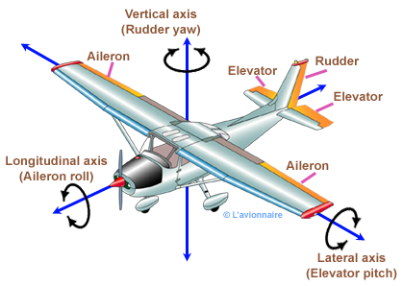
1. Aviation Basics & Mechanics of Flight
g. Identify and describe an aircraft’s primary control surfaces and how they affect the attitude and direction of flight.
Video
Notes:
Now, let's talk about the primary control surfaces on an airplane. These are the parts of the plane that the pilot uses to control the attitude (the orientation of the plane) and the direction of flight. There are four main control surfaces that work together to help the pilot steer and stabilize the aircraft in the air. Let’s break each one down:
1. Ailerons (Roll Control)
Location: Ailerons are located on the trailing edges of the wings, usually near the wingtips.
Function: Ailerons control the roll of the aircraft, which is when the airplane tilts side to side along its longitudinal axis (from nose to tail).
How they work:
When the pilot moves the control yoke or stick left or right, the ailerons move in opposite directions.
If the pilot turns the yoke to the right, the right aileron goes up, and the left aileron goes down. This causes the right wing to generate less lift (due to the upward aileron), while the left wing generates more lift (due to the downward aileron). This difference in lift causes the airplane to roll to the right.
Similarly, turning the yoke to the left causes the opposite effect, rolling the airplane to the left.
Effect on Attitude: Ailerons are primarily used to control roll and maintain level flight or to initiate a turn by banking the plane left or right.
2. Elevator (Pitch Control)
Location: The elevator is typically located on the horizontal stabilizer at the tail of the airplane.
Function: The elevator controls the pitch of the airplane, which is the up-and-down movement of the nose of the aircraft along its lateral axis (from wingtip to wingtip).
How it works:
When the pilot pulls back on the yoke or stick, the elevator moves up, which pushes the tail of the plane down and causes the nose to rise, making the plane climb.
When the pilot pushes forward on the yoke, the elevator moves down, causing the tail to rise and the nose to drop, making the plane descend.
Effect on Attitude: The elevator is responsible for controlling pitch, which directly affects the plane’s angle of attack and altitude. It determines whether the plane is climbing, descending, or flying level.
3. Rudder (Yaw Control)
Location: The rudder is located on the vertical stabilizer (the upright tail fin) of the airplane.
Function: The rudder controls the yaw of the airplane, which is the side-to-side movement of the nose along the vertical axis (from top to bottom).
How it works:
When the pilot pushes the rudder pedals to the right, the rudder moves to the right. This causes the nose of the airplane to yaw right.
Pushing the left rudder pedal causes the nose to yaw left.
Effect on Direction: The rudder helps the pilot maintain directional control (steering) of the aircraft, especially during turns or when flying in crosswinds. It also helps to keep the airplane coordinated in flight, preventing unwanted slipping or skidding.
4. Elevator Trim (Fine-tune Pitch)
Location: Elevator trim is also located on the horizontal stabilizer but is adjusted by a small wheel or control on the cockpit’s control panel.
Function: The elevator trim allows the pilot to make fine adjustments to the pitch of the airplane without having to continuously hold the control yoke or stick. It helps relieve the pilot from having to apply constant pressure on the controls to maintain level flight or a desired climb/descent.
How it works:
When the pilot adjusts the trim, it changes the position of a small trim tab on the elevator, allowing for subtle adjustments in the airplane’s pitch.
If the plane is climbing too steeply, the pilot can adjust the trim to help maintain the desired attitude without constantly pulling back on the yoke.
Effect on Attitude: The elevator trim is used for fine-tuning the pitch of the airplane to make it more comfortable to fly over long distances or maintain a consistent attitude.
How They All Work Together:
Roll (controlled by the ailerons) makes the plane bank left or right.
Pitch (controlled by the elevator) raises or lowers the nose, affecting climb and descent.
Yaw (controlled by the rudder) makes the nose of the plane swing left or right, helping with directional control.
In a typical flight, when a pilot wants to turn, they will:
Use the aileron to roll the plane in the direction of the turn.
Adjust the elevator to maintain the desired altitude during the turn.
Use the rudder to coordinate the turn, ensuring that the plane doesn’t "skid" or "slip."
In Summary:
Ailerons: Control roll (banking the aircraft left or right).
Elevator: Controls pitch (nose up or nose down).
Rudder: Controls yaw (nose left or right).
Trim: Fine-tunes the elevator to relieve pilot workload and maintain the desired pitch.
These primary control surfaces are essential for maintaining stable flight and changing the attitude and direction of the aircraft. By using all of them together, the pilot can maneuver the airplane safely and efficiently.

Slide 15
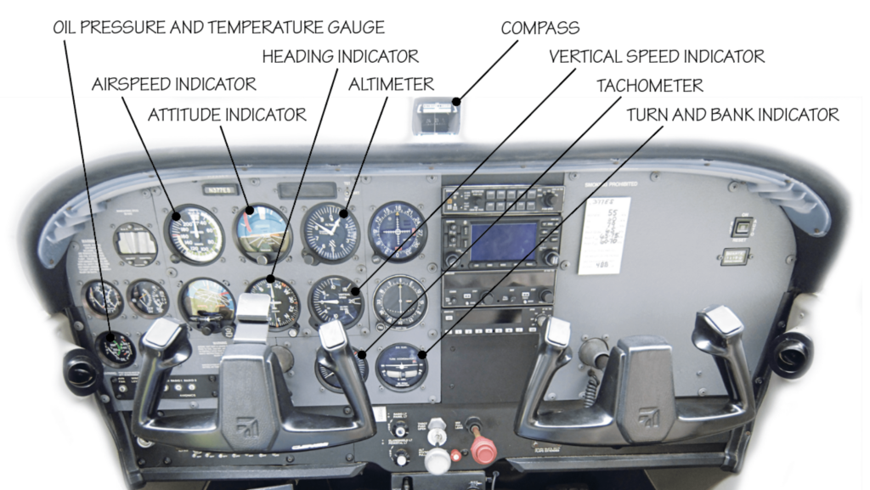
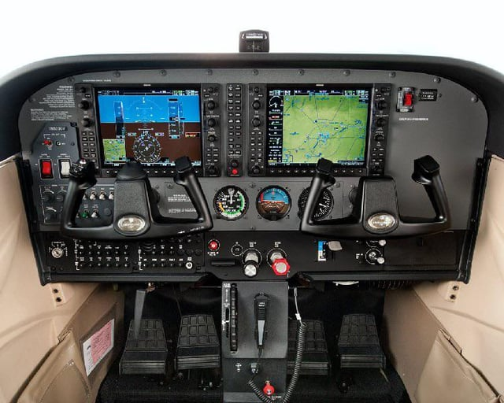
1. Aviation Basics & Mechanics of Flight
h. Explain the various instruments found in a typical single-engine airplane.
Traditional
“Steam Gauges”
Video
Modern
“Glass Cockpit”
Video
Notes:
Let’s dive into the basic descriptions and functions of these fundamental and important flight instruments. (Counselor – notes on “glass cockpits” are below).
1. Attitude Indicator
Function: Shows the aircraft’s orientation relative to the horizon (pitch and roll).
How it works: Displays a symbolic airplane and a horizon bar. If the plane is level, the airplane symbol is centered with the horizon bar. If the plane is climbing, descending, or turning, the airplane symbol moves up, down, or tilts.
Use: Helps pilots maintain correct pitch and roll, especially when flying in poor visibility.
2. Heading Indicator
Function: Displays the aircraft’s current compass heading (direction of flight).
How it works: A dial with headings (0° to 360°) that rotates to show the current heading of the aircraft.
Use: Helps pilots navigate in straight lines or maintain turns at specific headings.
3. Altimeter
Function: Shows the altitude of the aircraft above sea level.
How it works: Measures air pressure; as altitude increases, air pressure decreases. The altimeter converts this pressure into altitude readings.
Use: Allows pilots to monitor and adjust altitude during climbs, descents, and level flight.
4. Airspeed Indicator
Function: Displays the speed of the aircraft through the air.
How it works: Measures the difference between pitot pressure (from the aircraft’s forward motion) and static pressure (ambient air pressure).
Use: Helps pilots stay within safe operating speeds for takeoff, landing, and cruising.
5. Turn and Bank Indicator
Function: Shows the rate of turn and whether the airplane is in a coordinated flight (proper balance between roll and yaw).
How it works: A small ball inside a curved tube indicates if the plane is turning too steeply or if the turn is coordinated.
Use: Helps the pilot avoid uncoordinated flight, which can lead to a skid or slip.
6. Vertical Speed Indicator (VSI)
Function: Displays the rate of climb or descent.
How it works: Measures changes in static air pressure as the aircraft climbs or descends. The needle moves to show rate of climb (upward) or descent (downward).
Use: Helps pilots monitor and adjust the rate of climb or descent.
7. Compass
Function: Provides a basic magnetic heading reading (like the heading indicator but more basic).
How it works: Uses Earth's magnetic field to point to the magnetic north.
Use: Gives pilots a simple, reliable heading reference, especially in turns or when the heading indicator isn’t working.
These instruments are key to flying safely and efficiently, as they provide essential information about the aircraft’s attitude, direction, speed, altitude, and movement.
What is the difference between “steam gauges” and a “glass cockpit”?
Traditional Steam Gauges
Imagine a bunch of separate clocks on the wall. Each clock tells you something different—one shows how high you’re flying (altimeter), another shows how fast you’re going (airspeed indicator), and another shows which way the airplane is pointed (heading indicator).
You have to keep looking at all these clocks one by one to understand what’s going on with the airplane. This is how traditional steam gauges work.
Modern Glass Cockpits
Now, imagine a big, fancy tablet or TV screen that shows all this information in one place. It’s like a super-smart video game interface that combines everything into a single display. It might even show you cool stuff like a map, weather, and what the terrain looks like ahead of you.
This is how glass cockpits work. They’re digital and show more information in an easier-to-read way.
Comparison in Scouting Terms
Steam Gauges: Like using a compass, paper map, and stopwatch for a hike. You can get the job done, but it takes more effort and focus to keep checking each tool.
Glass Cockpit: Like using a GPS app on your phone that shows you your location, speed, and destination all at once. It’s faster and easier, but you need to know how to use the app.
Why It Matters:
Steam gauges are great for learning because they teach the basics of flying step by step.
Glass cockpits make flying easier and safer once you’re familiar with them, but they’re more advanced and can be overwhelming at first.
Pilots need to understand both because many older airplanes still use steam gauges, while most new planes have glass cockpits. Knowing both is like being able to navigate with a compass and a GPS!

Slide 16
Aviation Merit Badge: Requirements
Aviation Basics & Mechanics of Flight
Principles of Flight
Flight Operations
Airport Operations
Personal & Professional Aviation Opportunities
Notes:
2. Principles of Flight. Do ONE of the following:
Build a model FPG-9. Get others in your troop or patrol to make their own model, then organize a competition to test the precision of flight and landing of the models.
Build a rubber-band driven balsa wood airplane. Fly the plane for 25 feet, with a successful take-off and landing.
Build (or obtain) a fuel-driven or battery-powered electric model aircraft or drone. Obtain The Recreational UAS Safety Test (TRUST) certification, and fly the aircraft with a successful take-off and landing.

Slide 17
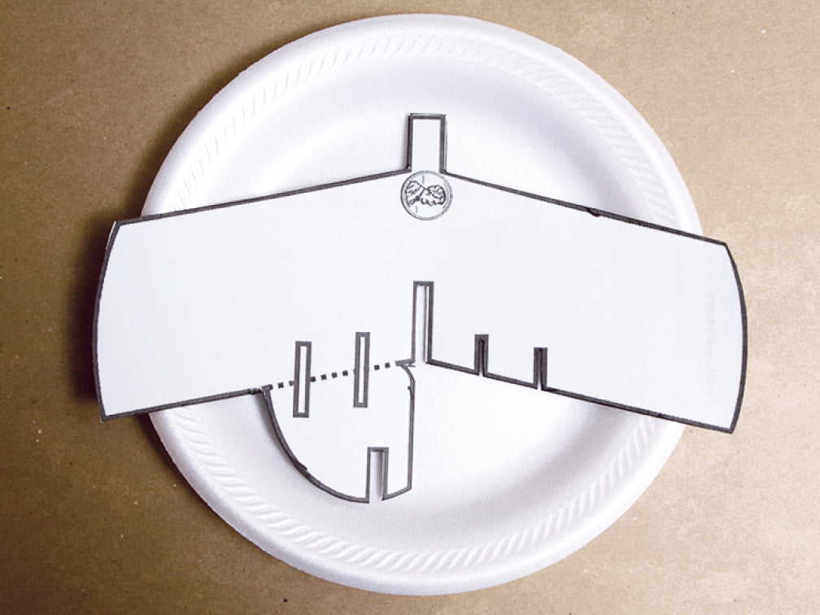
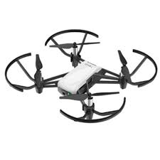
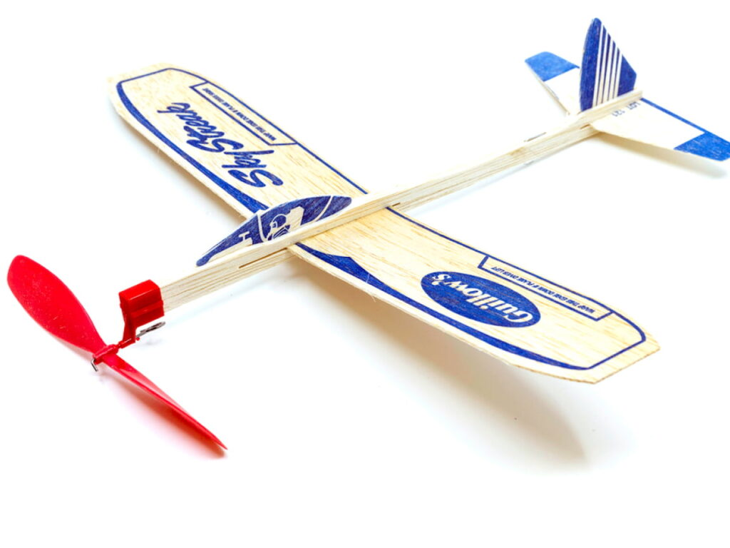
2. Principles of Flight
Do ONE of the following:
a. Build a model FPG-9
b. Build a rubber-band driven balsa wood airplane
c. Build or obtain a model aircraft or drone
Instructions
Purchase
Drone Exercise
Video
Video
Video
Notes:
FPG-9 Plane-Building Exercise
Objective: Build and fly a simple foam plate glider (FPG-9) to understand basic aerodynamics and flight mechanics.
Materials (per Scout)
9-inch foam plate (thin, sturdy plates work best)
Plastic drinking straw
Small binder clip (1” size works well for weight)
Scissors
Ruler
Pencil
Tape or glue (optional for reinforcement)
Step-by-Step Instructions
1. Prepare the Template
Print and distribute FPG-9 templates with clear markings for wings, tail fins, and fuselage (many templates are freely available online).
2. Cutting the Foam Plate
Have Scouts cut out the wing, tail, and rudder shapes from the foam plate using the template.
Ensure they cut carefully to maintain symmetry and precision.
3. Assembly
Attach the Wings:
Position the wings horizontally in the middle of the straw and tape them securely.
Attach the Tail:
Attach the horizontal stabilizer (tail wing) to one end of the straw.
Tape the vertical fin (rudder) on top of the tail wing.
4. Add the Weight
Clip the binder clip to the other end of the straw as ballast. This will balance the glider and help it fly straight.
5. Test and Adjust
Have Scouts test-fly their gliders indoors or outside.
Encourage them to make small adjustments:
Move the Binder Clip: Shifting it forward or backward changes the center of gravity and affects flight.
Bend the Wings: Slight bends can stabilize or alter flight paths.
Learning Connections
Aerodynamics: Discuss how wings generate lift and how the center of gravity affects stability.
Engineering: Highlight the importance of design precision and testing for improvement.
Problem-Solving: Encourage Scouts to troubleshoot and optimize their gliders for longer, straighter flights.
Enhancements and Challenges
Distance Competition: Measure whose glider flies the farthest.
Accuracy Test: Set up a target and see who can land closest.
Advanced Designs: Allow Scouts to modify or enhance their gliders, like adding winglets or adjusting the rudder.

Slide 18
2. Principles of Flight
Do ONE of the following:
a. Build a model FPG-9
b. Build a rubber-band driven balsa wood airplane
c. Build or obtain a model aircraft or drone
Instructions
Purchase
Drone Exercise
Video
Video
Video
Notes:
Rubber-Band Powered Balsa Wood Plane Exercise
Objective: Build and fly a rubber-band powered balsa wood plane to understand propulsion, lift, and aerodynamics.
Materials (per Scout)
Balsa wood plane kit (readily available online or at hobby stores – see link on slide)
Rubber bands (size and length suited to the kit specifications)
Glue (wood or craft glue)
Sandpaper (fine-grit for smoothing edges)
Scissors or a craft knife (with supervision)
Ruler and pencil
Paint or markers (optional for decoration)
Step-by-Step Instructions
1. Prepare the Workspace
Set up tables with all materials distributed.
Ensure Scouts work on flat surfaces and use tools safely.
2. Build the Plane
Wing Assembly:
Sand and smooth the edges of the wings for better aerodynamics.
Attach the wings to the fuselage according to the kit instructions.
Tail Assembly:
Attach the horizontal stabilizer and vertical fin.
Ensure they are aligned correctly to maintain balance during flight.
Propeller Mechanism:
Attach the rubber band and propeller assembly at the front.
Check that the propeller spins freely without obstruction.
3. Test and Adjust
Winding the Rubber Band:
Wind the rubber band 30–50 turns (depending on its elasticity).
Hold the plane lightly and release it for flight.
Flight Adjustments:
If the plane dives, adjust the tail to angle upward slightly.
If the plane stalls, add a small weight to the nose.
Experiment with rubber band tension for optimal flight distance.
Learning Connections
Physics of Flight
Thrust: The propeller converts the stored energy in the rubber band into forward motion.
Lift: The wings generate lift to keep the plane aloft.
Drag and Gravity: Discuss how these forces affect flight duration and distance.
Aircraft Design
Compare the Scouts’ planes to real propeller-driven aircraft.
Discuss how scaling up designs impacts engineering challenges.
Enhancements and Challenges
Distance Competition - See whose plane flies the farthest.
Longest Air Time - Challenge Scouts to modify their planes for maximum duration in the air.
Decorating Contest - Allow Scouts to decorate their planes and judge the most creative designs.
STEM Extensions:
Calculate the potential energy stored in the rubber band.
Use timers and rulers to collect flight data for analysis.
Safety and Supervision
Ensure safe use of sharp tools and adhesives.
Supervise winding of rubber bands to prevent snapping accidents.

Slide 19
2. Principles of Flight
Do ONE of the following:
a. Build a model FPG-9
b. Build a rubber-band driven balsa wood airplane
c. Build or obtain a model aircraft or drone
Instructions
Purchase
Drone Exercise
Video
Video
Video
Notes:
Drone Flying Exercise
Objective: Learn basic drone operation and safety while practicing flight maneuvers and understanding drone applications in aviation.
Materials
Mini-drones or beginner-friendly drones (e.g., DJI Mini 2, Holy Stone HS series, or similar).
Extra batteries and chargers.
Cones or markers for an obstacle course.
Safety equipment (e.g., goggles, gloves).
Landing pad (optional).
Notebook for Scouts to record their observations and performance.
FIRST – Ensure Scouts have achieved the TRUST certification! This is a mandatory requirement.
Step-by-Step Instructions
1. Pre-Flight Briefing
Safety Rules:
Always fly in an open, safe area.
Maintain visual line-of-sight at all times.
Respect people’s privacy and avoid flying over crowds.
Drone Basics:
Explain parts of the drone (frame, propellers, motors, camera, etc.).
Discuss flight controls (joystick movements for throttle, pitch, roll, and yaw).
2. Hands-On Setup
Pair Controllers: Ensure each Scout understands how to connect the drone to its controller.
Calibrate the Drone: If needed for that drone model, walk Scouts through calibrating the drone for a stable flight.
3. Flight Practice
Takeoff and Hover: Teach Scouts to take off smoothly and hover at a stable altitude.
Basic Maneuvers:
Move forward, backward, left, and right.
Practice turning (yaw) while maintaining hover.
Landing: Teach controlled landings.
4. Obstacle Course Challenge
Set up a course with cones or markers.
Include tasks like:
Flying through a series of hoops.
Precision landings on designated spots.
Navigating around obstacles.
5. Applications Discussion
Careers in Drones: Discuss uses in photography, agriculture, delivery, and search-and-rescue.
Real-World Scenarios: Create mock missions, such as delivering a small object or surveying a site.
Learning Connections
Principles of Flight
Compare how drones achieve lift and stability using rotors to how airplanes use wings.
Discuss how drones use GPS and gyroscopes for navigation and stability.
Aviation Technology
Highlight similarities and differences between piloting drones and airplanes.
Touch on FAA drone regulations and safe flying practices.
Enhancements and Challenges
Timed Course: Add a timer to make the obstacle course competitive.
Camera Use: If drones have cameras, challenge Scouts to take a photo or video from the air.
Teamwork Exercise: Assign roles (pilot, navigator, safety officer) for teamwork and communication practice.
STEM Extension: Discuss drone programming and automation basics, such as waypoints or pre-set routes.
Safety and Supervision
Limit drone use to a controlled area.
Ensure Scouts understand emergency procedures for losing control or low battery situations.
Aviation Merit Badge: Requirement 2 (c)
Requirement: Build (or obtain) and fly a fuel-driven or battery-powered electric model aircraft or drone. Describe safety rules for building and flying remote aircraft. Describe safety rules for fuel and/or battery packs.
Materials needed:
Drone(s). We used the DJI Tello drone (https://www.ryzerobotics.com/tello) which was relatively inexpensive (~$100) and extremely easy to set up and use. Ideally, each scout would pay a program fee so that you can provide each scout their own drone – but if not, easily shared.
Charging station. The batteries only last for ~15 minutes of flight time, and while 3 batteries are provided, they seem to drain quickly! Here is the setup I used:
Charging station: https://www.amazon.com/gp/product/B0CRR75PKS/ref=ppx_yo_dt_b_search_asin_title?ie=UTF8&th=1
Charging cables: https://www.amazon.com/gp/product/B09G61XCZN/ref=ppx_yo_dt_b_search_asin_title?ie=UTF8&psc=1
Obstacle course. Ours was courtesy of the Charlotte Drone Exploring Post, made out of 1 ½” PVC pipe (see photos). It’s actually quite easy to make your own! Alternatively you can use tables, chairs, hula-hoops, etc.
Helipads. These are completely optional, but very fun – especially if you set up an obstacle course race: https://www.amazon.com/gp/product/B097JT3LRV/ref=ppx_yo_dt_b_search_asin_title?ie=UTF8&psc=1
Mobile device(s). The drones connect to, and are controlled by, the mobile device. You may have to tweak the phone’s cellular settings, based on the phone/service provider. The drone connects to the hone via its own Wi-Fi (not Bluetooth)
Activity:
Drone safety rules:
Building/Flying: Ideally, have counselor or other trained adult complete the FAA-approved TRUST drone safety course: (https://www.faa.gov/uas/recreational_flyers/knowledge_test_updates)
Battery Packs: Review these materials with the Scouts: https://pilotinstitute.com/drone-battery-safety/
Drone set-up:
Make sure the battery packs are fully charged!
Mark each drone with the Scout’s last name, so they do not get mixed up. I used an Avery label-maker.
One at a time (so Wi-Fi names do not get mixed up), connect the phones to the drone. Download the Tello app and follow the instructions. Once connected, rename the Wi-Fi to the Scout’s name to avoid confusion.
Have one counselor teach the basic instructions for flying the drone, while the second counselor begins connecting the next Scout to their drone.
Individual flights:
Allow each Scout to fly their drone for 15-30 minutes; they may need to change battery packs.
Start indoors (if possible); then, when the Scout has sufficient proficiency, allow them to fly the drone outside in a clear field. Avoid trees!
Once they are comfortable with the drone operation (will vary by Scout), then show them how to take/record photos and videos on their phone.
Racing:
Once all Scouts are proficient with flying their drones, and recording photos/videos, they are ready to race!
Place two helipads on one end of the room (or field, if you need to do this outdoors). Create two duplicate obstacle courses. Pair up Scouts according to their abilities and have them race!
For the first round of races, allow the Scouts to “follow” their drones – and recover them as needed. For future races, make it more challenging by requiring them to operate the drone by looking at their phone ONLY – i.e., they cannot physically se the drone, only watching the video from the drone’s perspective. Then, if they “crash”, it’s game over for them!
Follow up:
Ask the Scouts for feedback – what did they think? What was easy for them, most difficult? What could have been better with the activity?
Share some of the opportunities for careers in piloting drones – real estate, surveillance, geographic surveying, etc.
Encourage them to fly their drones at camp, take photos/videos and share them with the Camp Director!

Slide 20
Aviation Merit Badge: Requirements
Aviation Basics & Mechanics of Flight
Principles of Flight
Flight Operations
Airport Operations
Personal & Professional Aviation Opportunities
Notes:
3. Flight Operations. Do TWO of the following:
Using a flight simulator software package, set a course and fly the headings you have established with a successful take-off and landing.
Under supervision, perform a preflight inspection of an aircraft.
Observe and/or participate in an aircraft maintenance activity. Describe the maintenance schedule and requirements for an aircraft of your choice.
Obtain and learn how to read an aeronautical chart. Measure a true course on the chart; correct it for magnetic variation, compass deviation, and wind drift to determine a navigational heading for an aircraft.
With your parents or guardian’s permission, take a discovery flight in an aircraft. Record the date, place, type of aircraft, and duration of flight. Report on your impressions of the flight.

Slide 21
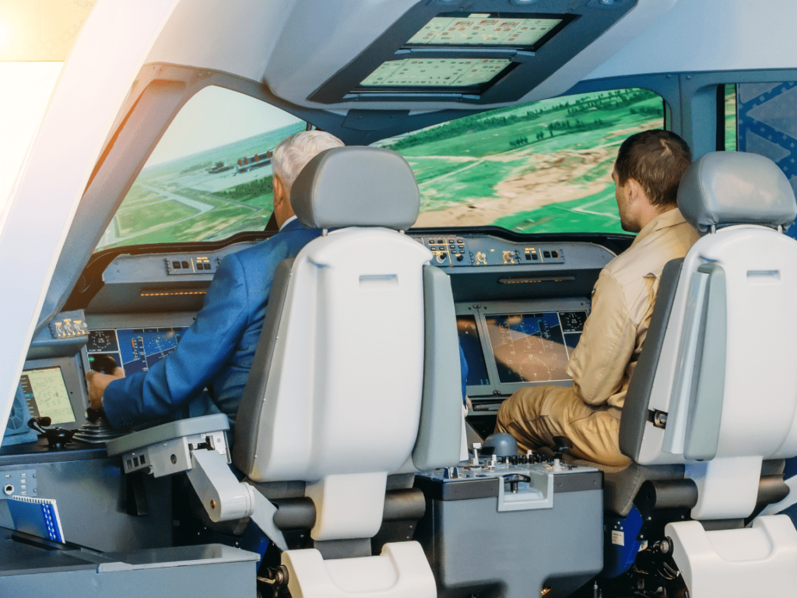
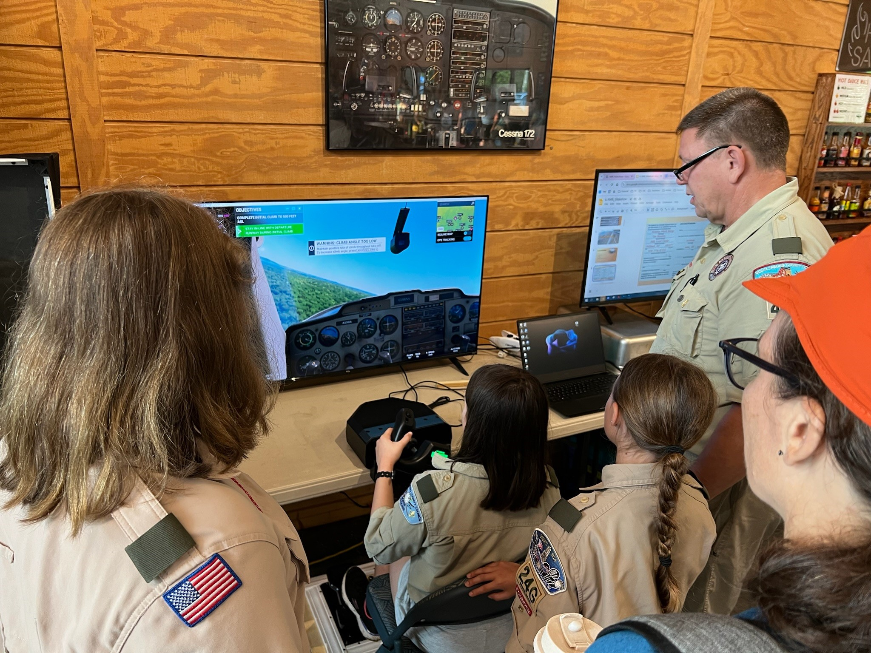
3. Flight Operations
Do TWO of the following:
a. Using a flight simulator software package, set a course and fly the headings you have established with a successful take-off and landing.
Video
Notes:
Here’s how you can set up the flight simulator exercise:
1. Choose the Right Flight Simulator
Options: Use software like Microsoft Flight Simulator, X-Plane, or a mobile-friendly app if computer access is limited.
Hardware: If possible, include a joystick, throttle, and rudder pedals for a more immersive experience.
2. Pre-Flight Preparation
Explain Key Concepts: Teach basic principles of flight (lift, thrust, drag, and gravity) and controls (yoke, throttle, rudder).
Aeronautical Charts: Show them how to read charts and discuss navigation basics.
Simulator Familiarization: Demonstrate the interface, controls, and how to read key instruments.
3. Create Realistic Scenarios
Beginner Task: Take off, fly a simple pattern, and land.
Intermediate Task: Navigate to a nearby airport using visual cues or waypoints.
Challenge: Introduce weather changes, system failures, or night flying for advanced participants.
4. Hands-On Practice
Divide the group into smaller teams for rotation.
Assign each Scout a role (pilot, co-pilot, navigator) for teamwork.
Provide checklists and guide them through the steps during their turn – see example below.
Beginner Flight Example Exercise
Objective: Take off, fly a rectangular pattern, and land safely at the same airport.
Pre-Flight
Launch Simulator Program: Select a single-engine aircraft (e.g., Cessna 172).
Set Airport: Choose a nearby airport with a long runway. Ideally use a nearby airport, ideally one they might visit for another requirement.
Adjust Weather: Clear skies, no wind for the first flight.
Review Instruments:
Airspeed Indicator
Altimeter
Heading Indicator
Throttle and Mixture
Takeoff
Throttle Full Forward: Gradually increase to takeoff power.
Monitor Airspeed: Rotate (lift nose) at around 55-60 knots.
Climb: Maintain a steady climb at about 75 knots, keeping wings level.
Flying the Pattern
Climb to Altitude: 1,000 feet AGL (Above Ground Level).
Turn to Crosswind: 90° left or right (based on runway direction).
Fly Downwind Leg: Parallel to the runway at level altitude.
Turn Base Leg: Another 90° towards the runway.
Turn Final Approach: Line up with the runway.
Landing
Reduce Speed: Adjust throttle to descend at a steady rate.
Flare: Gently pull back on the yoke/stick just before touchdown.
Full stop: Press toe brakes to come to a full stop, and turn off engine(s)
5. Tie It Back to the Merit Badge
Discuss how the activity relates to Aviation merit badge requirements, such as identifying aircraft instruments, learning about aerodynamics, or planning a cross-country flight.
6. Debrief and Feedback
After each session, gather the Scouts to discuss what they learned and enjoyed.
Encourage questions and provide insights into careers in aviation or hobbies like flight simulation.
7. Optional Enhancements
Bring in a local pilot or aviation expert to speak.
Connect the exercise to a visit to a local airport or aviation museum.
Use VR-compatible flight simulators for an even more immersive experience.

Slide 22
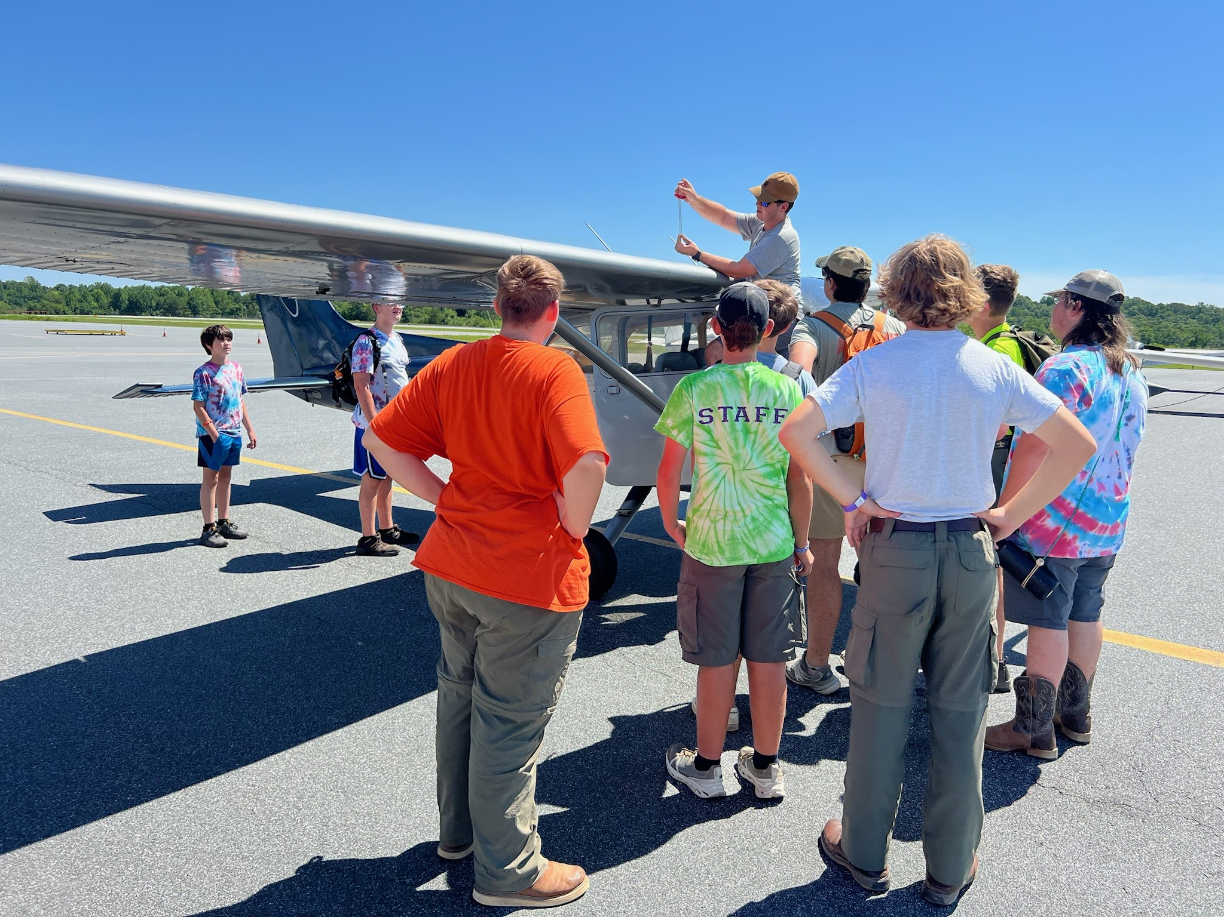
3. Flight Operations
Do TWO of the following:
b. Under supervision, perform a preflight inspection of an aircraft.
Video
Cessna 172 Pre-Flight Checklist
Notes:
Pre-flighting an airplane is a key learning experience for Scouts, offering hands-on exposure to aviation safety and procedures. Here’s how to structure the instruction:
Pre-Flight Inspection Exercise
Objective: Teach Scouts the steps to safely pre-flight a small aircraft (e.g., a Cessna 172) before their discovery flight.
Materials Needed
Access to an actual aircraft (coordinate with the flight school or airport).
Pre-flight checklist (provided by the flight school or downloadable from FAA resources).
Flashlight (for checking fuel levels and inspecting interior).
Safety cones (optional, to designate a safe area around the plane).
Step-by-Step Instruction Plan
1. Pre-Flight Briefing
Explain the importance of pre-flight inspections for safety and flight readiness.
Highlight the key areas Scouts will check: fuel, control surfaces, tires, engine, and overall airworthiness.
Go over the concept of “clean, secure, and functional” for every part of the inspection.
2. Hands-On Pre-Flight Inspection
Divide the pre-flight into sections, guiding Scouts step-by-step:
Exterior Walkaround
Wings:
Check for damage, cracks, or obstructions.
Inspect ailerons and flaps for smooth movement.
Ensure wing tip lights are not cracked or damaged in any way.
Fuselage:
Look for dents, loose panels, or leaks.
Tail:
Check the rudder and elevator for secure attachment and movement.
Ensure tail light is not cracked or damaged in any way.
Landing Gear
Check tires for wear, proper inflation, and debris in the wheel well.
Inspect struts and brake lines for damage or leaks.
Fuel and Oil
Fuel:
Use the fuel sampler to check for water or contaminants.
Confirm sufficient fuel levels and check caps for a secure fit.
Oil:
Check oil levels using the dipstick.
Propeller and Engine
Inspect the propeller for nicks or damage.
Check the engine cowling for leaks or loose screws.
Lights and Pitot Tube
Ensure all lights (navigation, strobe, and landing) are functional.
Check the pitot tube for blockages.
Interior Checks
Seats and Seatbelts: Ensure they are secure and functional.
Instruments and Controls: Verify everything is in the correct position.
Safety Gear: Confirm fire extinguisher and first aid kit are present.
3. Scout Participation
Assign Scouts specific roles or tasks (e.g., one checks the wings, another checks fuel).
Rotate roles to ensure everyone gets a chance to inspect different parts of the aircraft.
Learning Connections
Understanding Aircraft Systems
Discuss why each part of the inspection is critical for safety and functionality.
Developing Attention to Detail
Emphasize the importance of thoroughness in aviation safety.
Real-World Relevance
Explain how pilots use this procedure before every flight, regardless of their experience level.
Safety Considerations
Ensure Scouts are briefed on staying clear of propellers and other hazardous areas.
Supervise closely and maintain a safe perimeter around the plane.
Under no circumstances should a plane’s engine be running while near the Scouts!

Slide 23
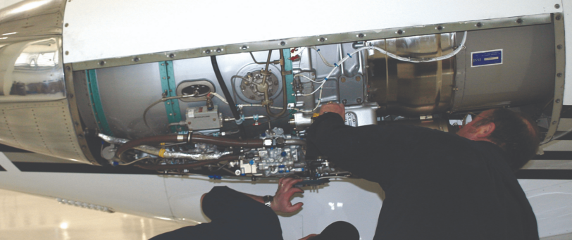
3. Flight Operations
Do TWO of the following:
c. Observe and/or participate in a maintenance activity.
Video
Notes:
Routine maintenance for a Cessna 172, or any general aviation aircraft, is essential to ensure airworthiness and compliance with FAA regulations. Here's an overview:
Overview of Routine Maintenance
Maintenance for a Cessna 172 follows a combination of time-based schedules and condition-based checks. Key guidelines come from the FAA and the aircraft manufacturer.
1. Pre-Flight Inspections (Pilot Responsibility)
Frequency: Before every flight.
Key Tasks:
Visual check of the aircraft's exterior and interior using a pre-flight checklist.
Sampling fuel to check for water or contaminants.
Inspecting control surfaces, tires, and propellers for damage or wear.
2. 100-Hour Inspections (If Used for Hire)
Frequency: Every 100 hours of flight time.
Performed By: A certified mechanic.
Key Tasks:
Inspecting and servicing the engine, including oil changes.
Checking flight control systems, avionics, and electrical systems.
Inspecting the landing gear and brake systems.
Verifying compliance with airworthiness directives (ADs).
3. Annual Inspections
Frequency: Once per calendar year, required by FAA regulations regardless of flight hours.
Performed By: An FAA-certificated A&P (Airframe and Powerplant) mechanic with Inspection Authorization (IA).
Key Tasks:
Comprehensive inspection of the entire aircraft.
Checking structural integrity (e.g., wings, fuselage, and tail).
Testing avionics, communication, and navigation systems.
Detailed inspection of the engine, including cylinder compression tests.
Reviewing maintenance records for compliance.
4. Oil Changes
Frequency: Every 25–50 hours of flight time or every 4–6 months, depending on usage and oil type.
Key Tasks:
Draining old oil and replacing it with fresh oil.
Replacing the oil filter and inspecting for metal particles, which could indicate engine wear.
5. Engine Maintenance
Scheduled Overhauls: Typically every 1,800–2,400 flight hours, depending on the engine model and manufacturer guidelines.
Tasks Include:
Replacing worn components like pistons, bearings, and seals.
Testing and recalibrating the fuel injection system or carburetor.
Inspecting and cleaning spark plugs, replacing as needed.
6. Airworthiness Directives (ADs)
Frequency: As issued by the FAA.
Purpose: Correct identified safety issues in specific aircraft models or systems.
Tasks Include:
Implementing modifications or repairs outlined in the AD.
7. Tires and Brakes
Frequency: Inspected regularly during pre-flight and routine maintenance.
Tasks Include:
Replacing worn or damaged tires.
Servicing or replacing brake pads and inspecting hydraulic lines.
8. Propeller Maintenance
Frequency: Inspected during every 100-hour and annual inspection.
Tasks Include:
Checking for nicks, cracks, or corrosion.
Balancing and aligning the propeller.
9. Corrosion Control
Frequency: Addressed during annual and other inspections.
Tasks Include:
Inspecting the airframe and control surfaces for signs of rust or corrosion.
Treating affected areas and applying corrosion inhibitors.
10. Avionics and Electrical Systems
Frequency: Inspected during every 100-hour and annual inspection.
Tasks Include:
Testing communication and navigation systems.
Checking battery health and electrical connections.
FAA Documentation and Compliance
Maintenance Logs: Detailed records of all inspections, repairs, and maintenance are required.
Airworthiness Certificate: Must remain valid, with compliance to all applicable ADs.
Pilot-Owner Preventative Maintenance: Certified pilots may perform certain basic tasks like replacing spark plugs or changing oil, under FAA guidelines (Part 43, Appendix A).

Slide 24
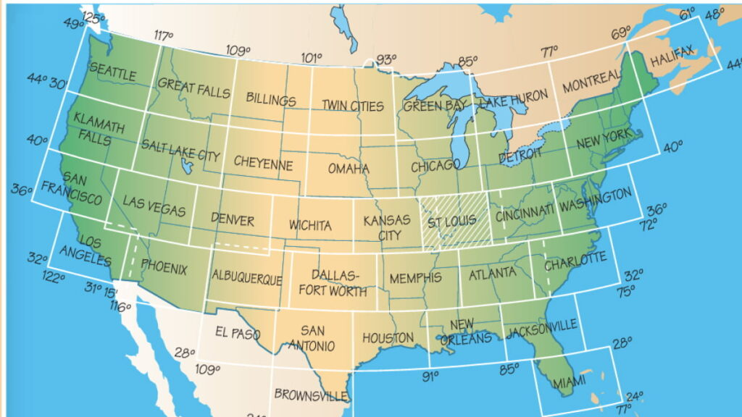
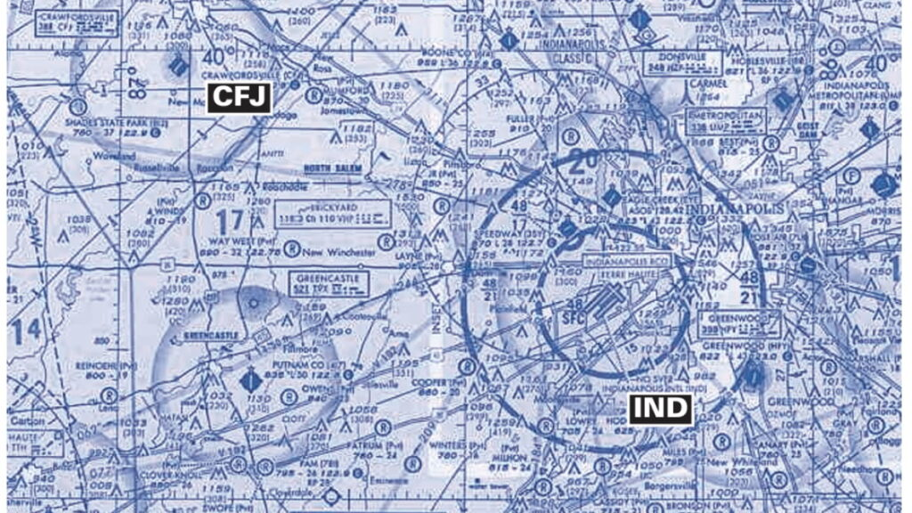
3. Flight Operations
Do TWO of the following:
d. Obtain and learn how to read an aeronautical chart.
Video
Notes:
A sectional aeronautical chart is a detailed map designed to assist pilots in navigation under Visual Flight Rules (VFR).
Here are the basics on how to read one:
1. Understanding Chart Basics
Scale: Sectional charts have a scale of 1:500,000 (1 inch = ~6.86 nautical miles).
Coverage: They provide details about topography, airspace, airports, and landmarks.
2. Key Features on the Chart
Terrain and Topography
Colors:
Light green to tan: Low elevations.
Darker browns: Higher elevations.
Contour lines: Show terrain elevation changes.
Shaded relief: Highlights terrain features like mountains and valleys.
Maximum Elevation Figure (MEF):
A large number in each grid rectangle indicating the highest elevation, including obstacles, within that area.
Obstructions
Towers and Obstacles:
Small black or magenta symbols with heights listed in feet above Mean Sea Level (MSL) and Ground Level (AGL).
Example: "1542" / "463" means 1,542 ft MSL and 463 ft AGL.
3. Airspace
Classes of Airspace:
Class A: High-altitude, not depicted on sectional charts.
Class B: Solid blue lines, major airports (e.g., around LAX, ORD).
Class C: Solid magenta lines, medium-sized airports.
Class D: Dashed blue lines, smaller towered airports.
Class E: Gradient shading or dashed magenta lines, typically above 1,200 ft AGL or surface.
Class G: Uncontrolled airspace, not explicitly marked, often below Class E.
Airspace Altitudes:
Numbers near airspace boundaries indicate altitude limits. For example, "SFC" (surface) to 10,000 ft MSL.
Prohibited, Restricted, and Special Use Airspace
Prohibited Areas (P): Blue hashed lines; no entry (e.g., White House).
Restricted Areas (R): Blue hashed lines; entry requires permission.
Warning Areas (W): Offshore military zones.
Military Operations Areas (MOA): Magenta hashed lines; caution advised.
Alert Areas (A): Magenta hashed lines; high pilot activity.
Temporary Flight Restrictions (TFRs): Check current status via NOTAMs.
4. Navigation Aids (NAVAIDs)
VOR Stations:
Depicted as blue hexagons with associated frequency.
Example: "113.4 VOR-DME" provides navigation guidance and distance.
Compass Roses:
Around VORs, indicating radials for navigation.
Victor Airways:
Light blue lines between VORs, indicating low-altitude airways.
5. Airports
Airport Symbols:
Blue: Towered airports.
Magenta: Non-towered airports.
Circle with runway lines: Indicates runways longer than 8,000 ft.
Small open circle: Smaller airports with limited facilities.
Information Blocks:
Airport Name: Includes the airport elevation and lighting.
Runway Details: Lengths and types (e.g., asphalt or grass).
6. Miscellaneous
Landmarks: Symbols for towns, highways, railroads, and water bodies.
Isogonic Lines: Dashed magenta lines showing magnetic variation.
Latitude and Longitude: Graticules for navigation or waypoint planning.
Flight Services Frequencies: Found in airport information blocks or near navigation aids.
Tips for Interpreting the Chart
Use the chart legend for unfamiliar symbols or terms.
Familiarize yourself with airspace boundaries and altitudes.
Cross-check elevations to ensure safe clearance from terrain and obstructions.
Pay attention to special use airspace and temporary flight restrictions (TFRs).

Slide 25
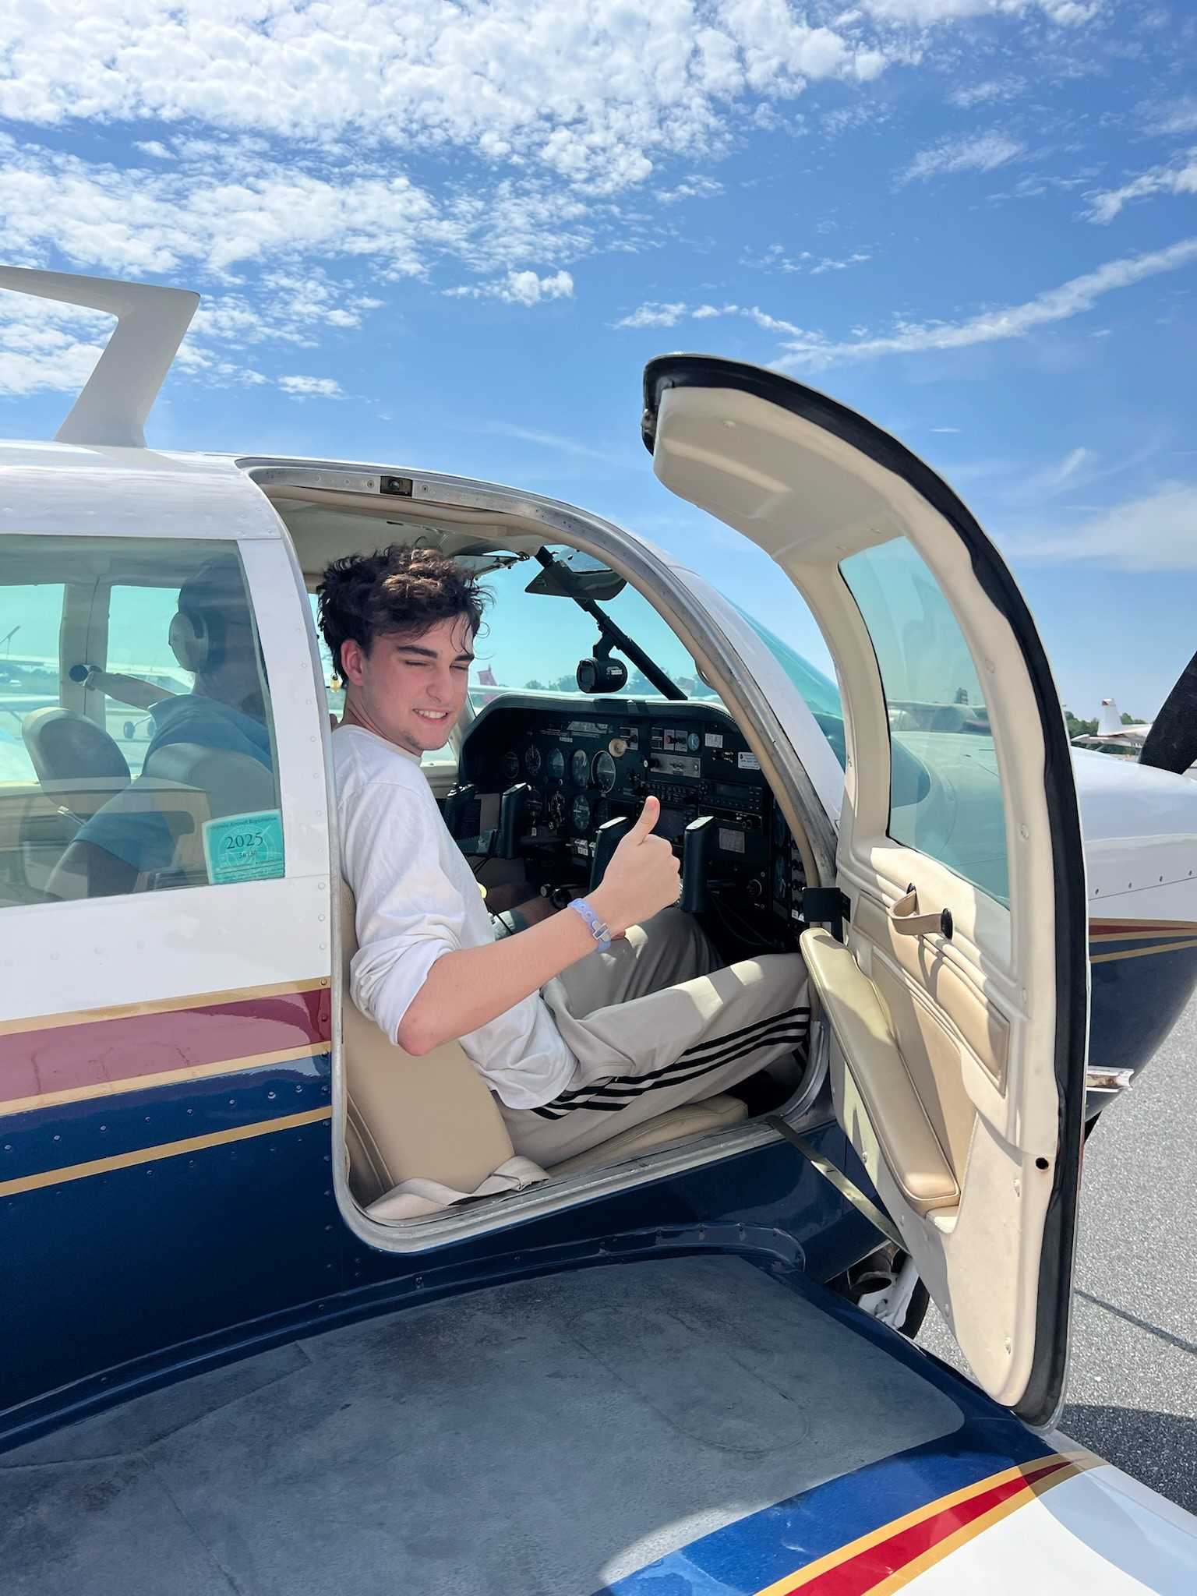
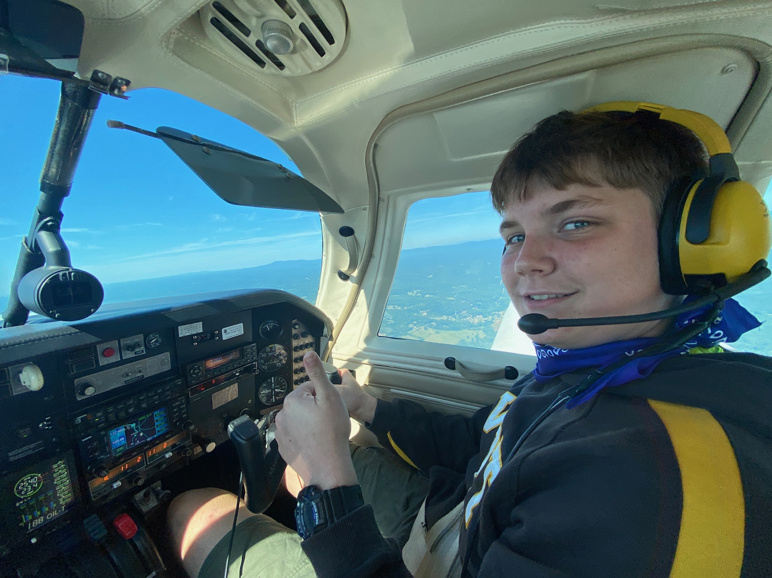
3. Flight Operations
Do TWO of the following:
e. With your parents or guardian’s permission, take a discovery flight in an aircraft.
EAA Chapter Locator
Parental Consent Form
Notes:
Setting up discovery flights for Scouts is an excellent way to inspire their interest in aviation. Organizations like the Experimental Aircraft Association (EAA) and local flight schools are great partners for this. Here’s how you can organize it:
Steps to Arrange Discovery Flights
1. Partner with Organizations
EAA Young Eagles Program:
This program offers free discovery flights for youth aged 8–17.
Visit the EAA website to find a local chapter and contact their Young Eagles coordinator.
EAA pilots are experienced and often combine the flight with an aviation education session.
Local Flight Schools and Airports:
Many flight schools offer discovery flights for a nominal fee.
Contact local schools or Fixed-Base Operators (FBOs) to negotiate group rates for Scouts.
2. Secure a Location
Identify a local airport that supports general aviation.
Coordinate with airport management for a safe area for the Scouts to gather and observe flight operations.
3. Organize Safety and Logistics
Scouting America Flying Plan Checklist: Complete this form and submit as instructed: https://filestore.scouting.org/filestore/pdf/680-672(17)FlyPlanFillable.pdf
Parental Consent: Collect signed consent forms from parents or guardians. See: https://filestore.scouting.org/filestore/pdf/19-673.pdf
Insurance: Verify coverage with the organization or flight school conducting the flights.
Group Size: Limit the number of Scouts per session to avoid long wait times.
4. Schedule the Event
Plan for several hours, including check-in, a pre-flight briefing, flights, and debriefing.
Create a staggered schedule if multiple pilots and aircraft are involved.
Event Day Agenda
Welcome and Introduction
Explain the purpose of the discovery flight.
Introduce the pilots and ground crew.
Pre-Flight Education
Walk Scouts through basic aviation principles and flight safety.
Demonstrate pre-flight inspection procedures (tying into the Aviation merit badge).
Discovery Flights
Each Scout takes a short flight (15–20 minutes), during which they can take the controls briefly under the pilot’s supervision.
Ensure other Scouts have engaging activities while waiting, such as:
Viewing airport operations.
Learning about careers in aviation.
Post-Flight Debrief
Have pilots discuss the flight experience with the Scouts.
Answer questions about flying and aviation careers.
Recognition and Documentation
Provide certificates of participation (EAA Young Eagles supplies these).
Encourage Scouts to log their flight time in an official pilot logbook.
Tips for Success
Engage Volunteers: Recruit parents, pilots, and aviation enthusiasts to assist with logistics and supervision.
Combine Activities: Pair flights with other aviation-related exercises like drone flying or building models to enhance the experience.
Prepare for Weather: Have a backup plan in case of poor weather conditions.

Slide 26
Aviation Merit Badge: Requirements
Aviation Basics & Mechanics of Flight
Principles of Flight
Flight Operations
Airport Operations
Personal & Professional Aviation Opportunities
Notes:
4. Airport Operations. Do ONE of the following:
Visit an airport. After the visit, report on how the facilities are used, how runways are numbered, and how runways are determined to be "active."
Visit a Federal Aviation Administration facility: Airport Traffic Control Tower (ATCT), Terminal Radar Approach Control (TRACON), Air Route Traffic Control Center (ARTCC), or Flight Standards District Office (FSDO). Report on the operation and your impressions of the facility.
Visit a military aviation facility. Learn how that facility supports defense and/or civilian activities. Report on the operation and your impressions of the facility.
Visit an aviation museum or attend an air show. Report on your impressions of the museum or show, and what you learned from the experience.

Slide 27
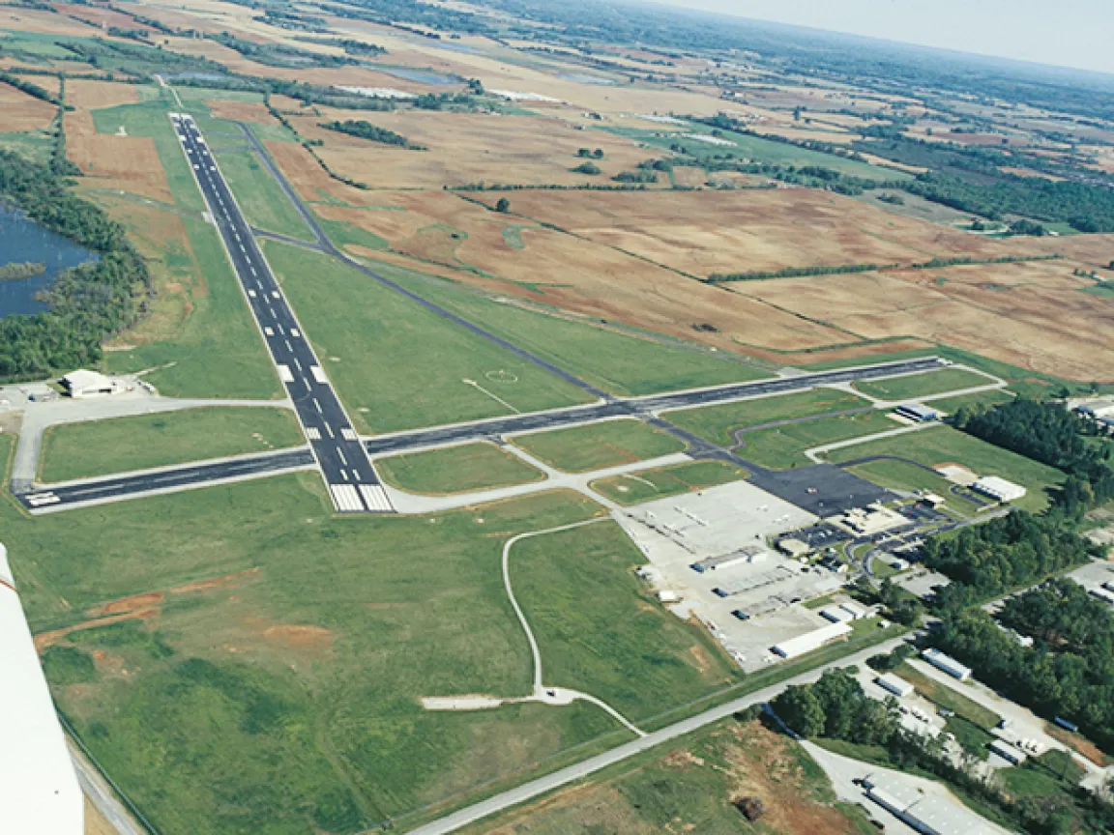
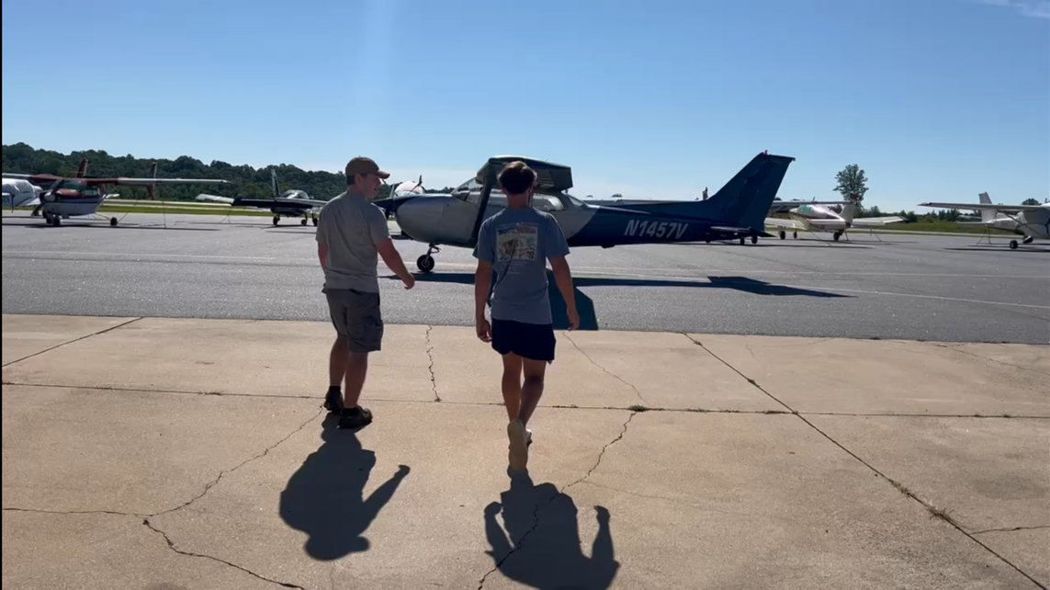
4. Airport Operations
Do ONE of the following:
a. Visit an airport.
Airport Locator
Notes:
An airport visit for Boy Scouts can be both educational and engaging, especially when tailored to cover essential aviation topics in a hands-on, interactive way.
Here's a suggested structure:
1. Introduction and Orientation (15–20 minutes)
Welcome and Safety Briefing:
Emphasize airport safety rules, such as staying in designated areas and wearing any required safety gear.
Highlight the importance of staying alert around moving aircraft.
Overview of the Day:
Share a schedule and goals (e.g., learn about airport operations, air traffic control, and aviation careers).
2. Airport Overview and Geography (20 minutes)
Tour of the Airport Layout:
Explain how airports are structured: terminal, apron, taxiways, runways, control tower, and hangars.
Show maps or a live view of the airport.
Runway Numbering:
Teach Scouts how runways are numbered based on their compass heading (e.g., Runway 18 = 180° south, Runway 36 = 360° north).
Highlight how parallel runways are labeled (e.g., 18L, 18R for left and right).
Taxiways:
Explain the difference between taxiways and runways:
Taxiways: Marked by yellow lines, used to move aircraft to and from runways and parking areas.
Runways: Used for takeoffs and landings, marked with white lines.
3. Visit the Control Tower (if the airport has one, and if possible) (30 minutes)
Role of the Control Tower:
Explain air traffic control's role in ensuring safe and efficient aircraft movement.
Demonstrate how controllers manage arrivals, departures, and ground traffic.
Live Demonstration:
If allowed, listen to live communication between the tower and pilots.
Discuss the phonetic alphabet and basic air traffic instructions like "cleared for takeoff" or "hold short.“
Weather Briefing: Include a session on how pilots use weather information and forecasts.
4. Aircraft and Equipment Tour (30–45 minutes)
Static Aircraft Display:
Show different types of aircraft (e.g., small private planes, corporate jets, or commercial planes).
Discuss parts of an airplane: fuselage, wings, engine, landing gear, control surfaces (e.g., ailerons, rudders, elevators).
Preflight Inspection Activity:
Demonstrate how to preflight an airplane (tie into merit badge requirements).
Let Scouts check fuel levels, inspect the exterior, and verify control surface movement.
5. Airport Services and Careers (20 minutes)
Behind-the-Scenes Roles:
Discuss various airport jobs: pilots, air traffic controllers, ground crew, mechanics, and engineers.
Visit the maintenance hangar or fuel station, if possible.
Fire and Rescue Services:
Visit the airport’s firefighting and emergency services, where available.
Highlight the importance of these teams during emergencies.
6. Hands-On Activities (Optional - 30–45 minutes)
Simulated Taxi and Takeoff:
Use a marked area or explain how pilots navigate taxiways and line up for takeoff.
Show how runway markings (e.g., thresholds, centerlines) guide pilots.
Interactive Challenges:
Use a map to have Scouts plan a mock taxi route.
Practice basic radio communication phrases using headsets or role-playing.
7. Wrap-Up and Q&A (15 minutes)
Recap Key Learnings:
Review topics covered, such as runway numbering, tower operations, and taxiways.
Thank You:
Thank airport staff and volunteers for their time. Encourage Scouts to write thank-you notes or letters.

Slide 28
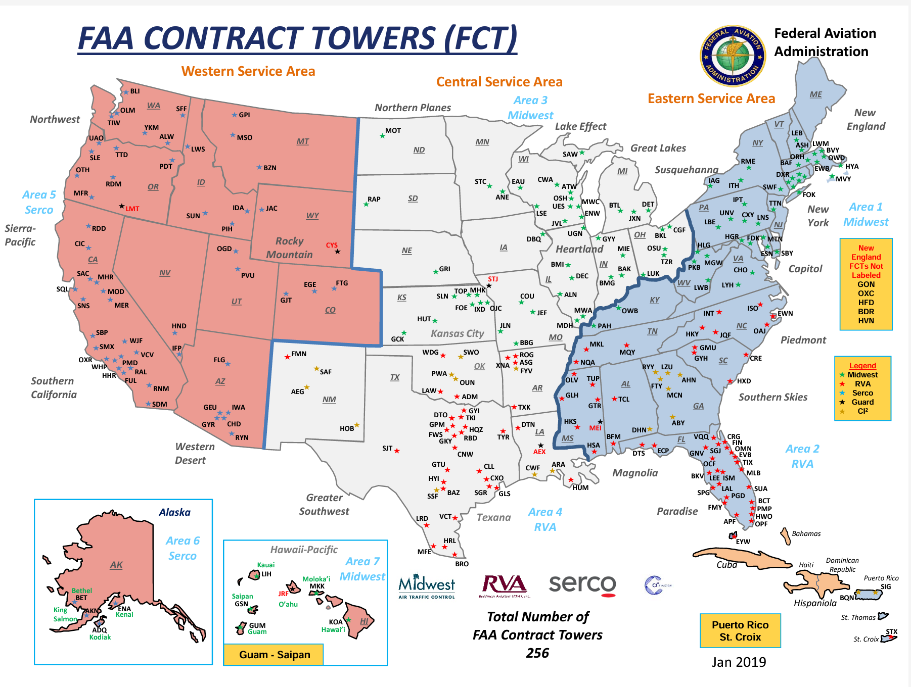
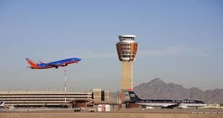
4. Airport Operations
Do ONE of the following:
b. Visit a Federal Aviation Administration (FAA) facility: Airport Traffic Control Tower (ATCT), Terminal Radar Approach Control (TRACON), Air Route Traffic Control Center (ARTCC), or Flight Standards District Office (FSDO).
FAA Facility Locator
Notes:
Visiting an FAA facility like a control tower, TRACON (Terminal Radar Approach Control), ARTCC (Air Route Traffic Control Center), or an FSDO (Flight Standards District Office) can provide Scouts with a unique and insightful experience into the world of aviation operations.
Here's a guide to organizing such a visit:
Steps to Organize the Visit
Contact the FAA Facility
Find a Nearby Facility:
Use the FAA's Facility Locator to identify local towers, TRACONs, ARTCCs, or FSDOs.
Reach Out to Schedule a Visit:
Call the facility and explain your group’s purpose (e.g., Aviation merit badge, introduction to aviation careers).
Ask about visitor policies, group size limits, and available dates.
Confirm Requirements
Age Restrictions: Some FAA facilities have age minimums (often 12 or older).
ID and Background Checks:
Many facilities, especially ARTCCs and TRACONs, require adult visitors to provide government-issued IDs. Scouts may need parental permission forms.
Group Size:
Most FAA tours limit group sizes for security and operational reasons. Verify the maximum number of attendees.
Prepare the Scouts
Safety and Behavior Briefing:
Emphasize respect for FAA staff, adherence to safety rules, and staying quiet when required.
Learn About Air Traffic Control:
Provide a basic overview of air traffic control and how it works. This helps Scouts understand what they’ll see and hear during the visit.
Tour Structure and Key Activities
1. Control Tower (ATCT)
Purpose:
Explain the tower’s role in managing aircraft on runways, taxiways, and within the airport’s immediate airspace.
Activities:
Observe controllers directing aircraft during takeoffs, landings, and ground movements.
Learn about tower communication protocols (e.g., phonetic alphabet, clearance instructions).
Key Features:
View radar displays, communication consoles, and the panoramic airfield view from the tower.
2. Terminal Radar Approach Control (TRACON)
Purpose:
Discuss how TRACON controllers manage aircraft as they enter and exit the airspace around major airports.
Activities:
Watch controllers sequencing aircraft for landing and departure using radar screens.
Understand how TRACON coordinates with control towers and ARTCCs.
3. Air Route Traffic Control Center (ARTCC)
Purpose:
Explain how ARTCC facilities manage enroute air traffic across large regions, often between states.
Activities:
Observe high-altitude radar operations and long-distance pilot communications.
Discuss how ARTCC works with other centers and military facilities for airspace coordination.
4. Flight Standards District Office (FSDO)
Purpose:
Learn how FSDOs oversee pilot certifications, flight schools, and aircraft maintenance compliance.
Activities:
Meet FAA inspectors and learn about their role in ensuring aviation safety.
Explore case studies of inspections or safety issues.
Interactive Learning Opportunities
Q&A with Controllers or FAA Staff:
Encourage Scouts to ask about careers, training paths, and the day-to-day life of air traffic controllers or FAA inspectors.
Hands-On Demonstrations:
In some facilities, staff might simulate ATC operations or show how radar systems track aircraft.
Educational Handouts:
Request handouts or materials (e.g., maps, radar screenshots) for Scouts to review later.
Wrap-Up
Debrief Session:
After the visit, gather Scouts to discuss what they learned, their favorite part of the tour, and any follow-up questions.
Follow-Up Activities:
If available at that location, combine the experience with a flight simulator exercise to reinforce concepts.
Have Scouts write thank-you letters to the FAA staff, reflecting on their experience.
Additional Tips
Plan Early: FAA facilities often require weeks or months of advance notice to schedule group tours.
Be Flexible: Operational demands can sometimes alter or shorten the visit; be prepared for changes.
Be Thankful: Make sure you (and the Scouts!) thank their hosts for the visit, and the investment of their time.

Slide 29
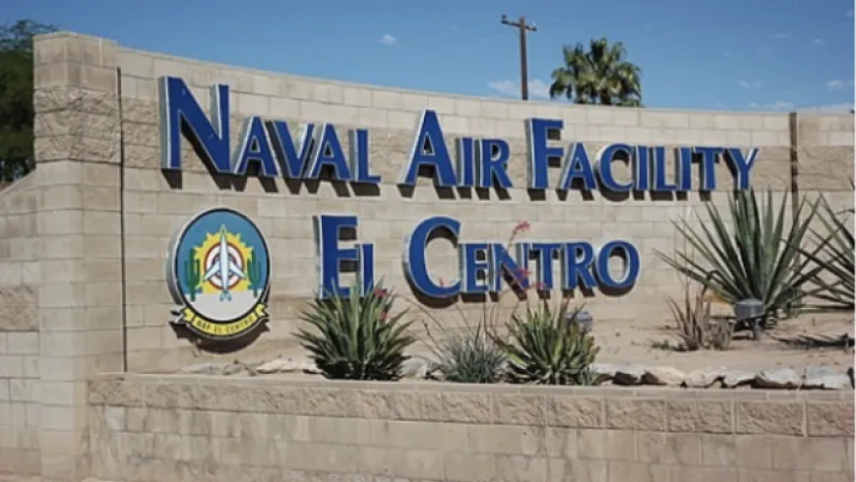

4. Airport Operations
Do ONE of the following:
c. Visit a military aviation facility. Learn how that facility supports defense and/or civilian activities.
Military Installation Locator
Notes:
Visiting a military aviation facility can be an exciting and informative experience for Scouts. Here’s how you can organize the visit and ensure it meets the requirements while engaging Scouts in learning about the role of military aviation in defense and civilian support:
Steps to Organize the Visit
Identify a Nearby Military Aviation Facility
Common options include Air Force bases, Naval Air Stations, Army Aviation Units, or Coast Guard Air Stations.
Use Military Installations Locator (link on slide) to find facilities near you.
Contact the Base or Facility
Public Affairs Office (PAO): Reach out to the base’s Public Affairs Office to inquire about group tours. Mention that the purpose is to support Scouts in earning their Aviation merit badge.
Local Recruiting Offices: Recruiters can sometimes facilitate visits or arrange introductions to aviation units.
Confirm Visit Details
Security Requirements:
Check for identification and permission forms, as military installations often have strict access protocols.
Group Size and Age Limits:
Verify whether there are restrictions on the number of visitors or minimum age requirements.
Photography Rules:
Ask about restrictions on taking photos or videos.
Prepare Scouts for the Visit
Basic Military Aviation Overview:
Teach Scouts about that branch of military, and its aviation capability and roles.
Learn Military Terminology:
Brief Scouts on rank structure, call signs, and radio communication to enhance understanding during the visit.
Tour Structure and Key Activities
1. Facility Overview
Welcome Briefing: The tour typically starts with an introduction by military personnel, explaining the facility’s mission and its role in defense.
Facility Layout: Tour the key areas, such as hangars, control towers, maintenance shops, and operational areas.
2. Discussion of Roles and Missions
Defense Operations:
Discuss how the facility supports national defense, including:
Air combat missions.
Reconnaissance and surveillance.
Search and rescue operations.
Logistics and transport missions.
Civilian Support:
Learn how the facility aids civilians, such as:
Disaster relief and humanitarian missions.
Search and rescue for missing civilians.
Medical evacuation flights.
3. Aircraft and Equipment Tour
Static Displays:
View military aircraft, helicopters, or drones.
Discuss the unique capabilities of these aircraft (e.g., stealth technology, high-speed intercepts, heavy-lift cargo).
Hands-On Demonstration:
If allowed, sit inside a cockpit, explore instrumentation, or watch maintenance crews at work.
4. Special Demonstrations (if possible)
Live Operations:
Observe live flight operations, takeoffs, or landings (if safety and operational tempo permit).
Simulators:
Some facilities may offer access to flight simulators for hands-on experience.
K-9 Units or Security Displays:
Learn about how military aviation bases secure their airfields and assets.
Wrap-Up and Reflection
Q&A Session:
Allow Scouts to ask military personnel questions about their work and experiences.
Discussion:
Recap the key points learned, such as:
How military aviation protects national interests.
How it provides essential support to civilian activities.
Thank You Notes:
Encourage Scouts to write thank-you letters to the facility staff.
Additional Tips
Check for Special Events:
Coordinate visits with public events like airshows or Armed Forces Day, which may include additional displays and activities.
Be Flexible:
Military operations take precedence, so be prepared for schedule changes or restrictions.

Slide 30


4. Airport Operations
Do ONE of the following:
d. Visit an aviation museum or attend an air show.
Notes:
Visiting an aviation museum is a fantastic way for Scouts to explore the history, technology, and significance of aviation in a hands-on and engaging environment. Here's how to plan a visit and make it educational and fun:
Steps to Organize the Visit
Find a Nearby Aviation Museum
Use directories like the Smithsonian Affiliations or search for local museums that focus on aviation or aerospace.
Popular examples include:
National Air and Space Museum (Washington, D.C.)
EAA Aviation Museum (Oshkosh, WI)
National Museum of the U.S. Air Force (Dayton, OH)
Intrepid Sea, Air & Space Museum (New York, NY)
Sullenberger Aviation Museum (Charlotte, NC
Smaller local museums like regional airfield museums or state aviation history museums.
Contact the Museum
Group Tours:
Inquire about Scout-friendly group tours, docent-led programs, or specialized activities.
Hands-On Exhibits:
Ask about flight simulators, aircraft walk-throughs, or interactive displays.
Workshops and Programs:
Some museums offer STEM workshops or merit badge-specific activities.
Prepare Scouts for the Visit
Set Learning Goals:
Focus on topics like the evolution of aircraft, aviation pioneers, or how aviation impacts everyday life.
Assign Roles:
Have Scouts prepare questions to ask docents or assign them to document specific exhibits.
Tour Structure and Key Activities
1. Museum Orientation (15–20 minutes)
Welcome and Overview:
A docent or guide introduces the museum’s mission, layout, and highlights.
Safety and Etiquette:
Remind Scouts to respect exhibits and follow museum rules (e.g., no touching unless allowed).
2. Thematic Exhibits Tour (45–60 minutes)
Aircraft and Technology:
Walk through displays of historical and modern aircraft.
Learn about significant milestones in aviation, such as the Wright brothers, World War I/II aviation, and the jet age.
Hands-On Experiences:
Sit in cockpits (if allowed) or use interactive exhibits like flight simulators or VR experiences.
Examine the mechanics of aircraft engines, navigation tools, or aerodynamics demonstrations.
3. Aviation Pioneers and Careers (20 minutes)
Stories of Aviators:
Highlight individuals like Amelia Earhart, Charles Lindbergh, or modern astronauts.
Careers in Aviation:
Discuss how the museum inspires young people to explore careers in aviation or aerospace.
4. Special Features (Optional)
Live Demonstrations:
Some museums have live aircraft demonstrations or restoration workshops – ask in advance, and perhaps even plan around special events!
Temporary Exhibits:
Check for traveling exhibits that might align with Scout interests (e.g., space exploration or drone technology).
5. Scout Activities (30–45 minutes)
Scavenger Hunt:
Create a checklist of key exhibits or facts for Scouts to find during the visit.
Group Discussions:
Have Scouts identify their favorite aircraft and explain its historical significance.
Hands-On STEM Activity:
Many museums offer STEM workshops, such as building model planes or learning about aerodynamics.
Wrap-Up and Reflection
Closing Discussion:
Gather Scouts to share their favorite parts of the museum and what they learned.
Connect exhibits to Aviation merit badge requirements, such as aviation history, aircraft systems, or careers.
Thank You Notes:
Encourage Scouts to write thank-you letters to the museum staff or docents who guided the tour.
Tips for Success
Plan a Hands-On Session:
Pair the visit with a model-building activity or a discussion of a Scout’s favorite aircraft.
Schedule Time for Exploration:
Leave time for Scouts to explore on their own and engage with exhibits that interest them most.

Slide 31
Aviation Merit Badge: Requirements
Aviation Basics & Mechanics of Flight
Principles of Flight
Flight Operations
Airport Operations
Personal & Professional Aviation Opportunities
Notes:
5. Personal & Professional Aviation Opportunities. Do the following:
Explain the following: the student pilot, the recreational pilot, the remote pilot, and the private pilot certificates.
Describe the benefits of the instrument rating.
Explain the following: the commercial pilot certificate, the airline transport pilot certificate, and certified flight instructor (CFI).
Identify an Aviation Exploring Post and/or Civil Air Patrol facility in your area. Learn about their activities and membership requirements.
Identify three career opportunities that would use skills and knowledge in aviation. Pick one and research the training, education, certification requirements, experience, and expenses associated with entering the field. Research the prospects for employment, starting salary, advancement opportunities and career goals associated with this career. Discuss what you learned with your counselor and whether you might be interested in this career.

Slide 32


5. Personal & Professional Opportunities
a. Explain the following: student pilot, recreational pilot, remote pilot, and private pilot certificates
Become a
Pilot
Remote / Drone
Pilot
Notes:
Each certificate is tailored to different goals and levels of responsibility. Here’s an explanation of the various types of pilot certificates:
1. Student Pilot Certificate (see below for more info on this one)
Purpose: The first step for anyone learning to fly. This certificate allows individuals to operate an aircraft solo under the supervision of a flight instructor as they build experience and work toward a higher certificate.
Requirements:
Be at least 16 years old (14 for gliders or balloons).
Pass a medical exam (unless operating gliders or balloons).
Obtain a student pilot certificate from the FAA.
Restrictions:
Cannot carry passengers or fly for hire.
Cannot fly in bad weather or outside specific airspace without authorization.
Training Path:
Focuses on basic flight operations, safety, and preparation for solo flights.
Usually leads to a recreational or private pilot certificate.
2. Recreational Pilot Certificate
Purpose: Allows pilots to fly for personal enjoyment within specific limitations.
Requirements:
Be at least 17 years old.
Obtain a minimum of 30 flight hours (15 with an instructor).
Pass a written knowledge test and a practical flight test.
Privileges:
Fly single-engine aircraft with up to four seats.
Can carry up to one passenger.
Restrictions:
Daytime flying only (no night flights).
Cannot fly more than 50 nautical miles from the departure airport without special training.
No flying in controlled airspace without additional endorsements.
Recreational pilots often upgrade to a private pilot certificate for more freedom.
3. Remote Pilot Certificate (Drone License)
Purpose: For operating small unmanned aircraft systems (drones) commercially or for official purposes.
Requirements:
Be at least 16 years old.
Pass the FAA's Aeronautical Knowledge Test or complete a training course (for existing Part 61 certificate holders).
Register the drone with the FAA if it weighs more than 0.55 lbs.
Privileges:
Fly drones for commercial purposes (e.g., photography, mapping, inspections).
Operate drones under Part 107 rules, which cover altitude, visibility, and airspace restrictions.
Limitations:
Must maintain visual line of sight with the drone.
Cannot fly over people, in restricted airspace, or beyond visual line of sight without waivers.
Renewal:
Certification must be renewed every two years through a recurrent knowledge test.
4. Private Pilot Certificate
Purpose: The most common certificate, allowing pilots to fly aircraft recreationally or for personal travel.
Requirements:
Be at least 17 years old.
Accumulate at least 40 flight hours (20 with an instructor, 10 solo).
Pass a written knowledge test, a medical exam, and a practical flight test.
Privileges:
Fly most single-engine airplanes (with additional ratings for others).
Carry passengers (but cannot charge for flights).
Fly day or night under Visual Flight Rules (VFR).
Restrictions:
Cannot be paid for flying (except for pro-rata sharing of expenses).
Requires additional certifications or ratings for instrument flying, multi-engine aircraft, or commercial operations.
Private pilots often add advanced certifications, like instrument or commercial pilot certificates.
The most popular way for people to obtain their student pilot certificate is through enrollment in a flight school or working directly with a Certified Flight Instructor (CFI). Here’s a step-by-step outline of the process:
1. Enroll in a Flight School or With a Flight Instructor
Flight Schools:
Most aspiring pilots start at a Part 61 or Part 141 flight school. These schools are certified by the FAA and specialize in providing structured flight training.
Part 141 schools are typically more formalized with set curricula, often associated with collegiate aviation programs, while Part 61 schools offer more flexibility in scheduling and pacing.
Individual Flight Instructors (CFIs):
Some students work one-on-one with a private CFI who operates independently or through a small flying club.
2. Obtain a Medical Certificate
Why It’s Important:
To ensure the student is physically and mentally fit to operate an aircraft safely.
For most aircraft types, students must pass an FAA medical exam with an Aviation Medical Examiner (AME).
Steps:
Find an AME through the FAA’s website.
Schedule a medical exam (Class 3 medical is the most common for student pilots).
Pass the medical to meet the health requirements.
3. Apply for the Student Pilot Certificate
Application Process:
Go to the FAA’s Integrated Airman Certification and Rating Application (IACRA).
Create an account and complete the student pilot certificate application.
Submit the application through your CFI, a flight school representative, or the FAA Flight Standards District Office (FSDO).
No Fee:
The student pilot certificate is free.
Certificate Issuance:
Once approved, the FAA will mail the plastic student pilot certificate to the applicant. A temporary certificate can be downloaded for immediate use.
4. Begin Flight Training
Once the certificate is received, the student can officially begin flight training, including solo flight operations under the supervision of their instructor.
Typical Training:
Dual instruction flights to learn basic maneuvers, takeoffs, landings, and emergency procedures.
Solo flights when the instructor determines the student is ready.
Why Flight Schools Are the Most Popular Path
Comprehensive Support:
Flight schools streamline the process by providing guidance on medical exams, student pilot certificates, and flight training.
Access to Resources:
Schools offer certified instructors, aircraft rental, ground schools, and testing preparation.
Networking and Community:
Students gain access to aviation communities, making it easier to stay motivated and progress through training.
Key Considerations
A student pilot certificate is required only for solo flights. Early dual flight training with an instructor does not require it.
Aspiring pilots should start their training as soon as they complete their medical exam and certificate application to maximize efficiency.
ATP Flight School is recognized as the largest flight training organization in the United States. Established in 1984, ATP has expanded to operate over 80 training centers nationwide, offering aspiring pilots extensive accessibility and flexibility.
Key Features of ATP Flight School:
Comprehensive Training Programs: ATP provides a range of programs, including private pilot certification, instrument ratings, and commercial pilot training. Their flagship Airline Career Pilot Program is designed to guide students from zero experience to airline-ready pilots efficiently.
Extensive Fleet and Facilities: With a large fleet of standardized aircraft and advanced flight simulators, ATP ensures consistent and high-quality training experiences across all locations.
Airline Partnerships: ATP has established relationships with numerous regional airlines, providing graduates with pathways to employment and career advancement opportunities.
While ATP Flight School is a prominent choice, other reputable institutions also offer quality flight training:
Embry-Riddle Aeronautical University: Known as "The Harvard of the Skies," Embry-Riddle offers comprehensive aviation programs and has campuses in Daytona Beach, Florida, and Prescott, Arizona.
University of North Dakota (UND): UND's John D. Odegard School of Aerospace Sciences provides a diverse range of aviation degrees and operates one of the largest civilian aircraft fleets in North America.
When selecting a flight school, consider factors such as location, program offerings, cost, and how well the school's training approach aligns with your career objectives. Visiting campuses, speaking with current students, and reviewing each school's success rates can provide valuable insights to inform your decision.

Slide 33

5. Personal & Professional Opportunities
b. Describe the benefits of the instrument rating.
Video
Notes:
An instrument rating is an advanced certification that allows pilots to fly under Instrument Flight Rules (IFR), meaning they can operate in low visibility conditions using instruments instead of visual references. Here's a breakdown of the requirements and benefits of earning an instrument rating:
Requirements for an Instrument Rating
Prerequisite: You must hold at least a private pilot certificate.
Flight Experience:
Accumulate a minimum of 50 hours of cross-country flight time as pilot-in-command (PIC).
Complete at least 40 hours of actual or simulated instrument time, including:
15 hours of instrument training with a Certified Flight Instructor – Instrument (CFII).
One cross-country flight under IFR conditions, including:
A flight of at least 250 nautical miles.
Use of airways or ATC-directed routing.
Instrument approaches at three different airports.
Ground Training: Complete ground school instruction focused on instrument procedures, weather theory, IFR regulations, navigation, and avionics.
Written Knowledge Test: Pass the FAA Instrument Rating Knowledge Test (60 multiple-choice questions covering IFR topics).
Practical Test (Checkride): Demonstrate proficiency in IFR operations during a checkride with an FAA examiner or designated pilot examiner. The checkride involves:
Pre-flight planning and weather interpretation.
Demonstration of instrument approaches, holds, and en-route procedures.
Recovery from unusual attitudes.
Benefits of an Instrument Rating:
Ability to Fly in IFR Conditions: Pilots can fly in poor visibility conditions, such as clouds, fog, rain, or at night, greatly expanding flying opportunities.
Enhanced Safety: Provides skills to handle unexpected weather conditions and navigate safely using only instruments, and reduces the risk of accidents caused by spatial disorientation or inadvertent entry into Instrument Meteorological Conditions (IMC).
Access to Controlled Airspace: Pilots with an instrument rating can navigate more efficiently in controlled airspace, including Class A airspace (above 18,000 feet).
Improved Precision: Teaches pilots advanced navigation and situational awareness, improving their overall flying skills.
Career Advancement: An instrument rating is a necessary step for pilots aspiring to become commercial pilots, airline pilots, or flight instructors.
Increased Reliability for Travel: With an instrument rating, flights are less likely to be delayed or canceled due to weather, making it more reliable for personal and business travel.
Additional Notes
An instrument rating does not allow a pilot to fly in all weather conditions, as certain severe weather (e.g., thunderstorms or icing) is still unsafe even with IFR skills.
Maintaining instrument currency is required – you must complete at least 6 instrument approaches within the previous 6 months or participate in an Instrument Proficiency Check (IPC) with a CFII.

Slide 34



5. Personal & Professional Opportunities
c. Explain the following: Commercial Pilot Certificate, Airline Transport Pilot Certificate, and Certified Flight Instructor.
ATP Pilot
Commercial Pilot
CFI Pilot
Notes:
Here’s a detailed explanation of the Commercial Pilot Certificate, Airline Transport Pilot Certificate, and Certified Flight Instructor Certificate:
1. Commercial Pilot Certificate
Purpose: Allows pilots to earn money for flying.
Requirements:
Be at least 18 years old.
Hold at least a private pilot certificate.
Accumulate a minimum of:
250 total flight hours (Part 61) or 190 hours (Part 141 schools).
100 hours as pilot-in-command (PIC).
50 hours of cross-country flight time.
10 hours of instrument training.
10 hours of training in a complex aircraft or technically advanced airplane (TAA).
Pass a second-class medical exam.
Complete the FAA written knowledge test and a practical test (checkride).
Privileges:
Perform paid flight duties, such as aerial tours, banner towing, ferry flights, crop dusting, or cargo transport.
Does not allow flying as a captain for airlines (requires an Airline Transport Pilot Certificate).
Limitations:
Without an instrument rating, commercial pilots are restricted to daytime flights and within 50 nautical miles of the originating airport.
Next Steps:
Many commercial pilots continue training to earn an Airline Transport Pilot (ATP) certificate.
2. Airline Transport Pilot (ATP) Certificate
Purpose: The highest level of pilot certification, required to act as captain (Pilot in Command) for airlines.
Requirements:
Be at least 23 years old.
Hold a commercial pilot certificate and instrument rating.
Accumulate a minimum of 1,500 total flight hours, including:
500 hours of cross-country time.
100 hours of night flight.
75 hours of instrument flight.
250 hours as Pilot-in-Command (PIC).
Pass a first-class medical exam.
Complete ATP-specific ground school and simulator training.
Pass the ATP written knowledge test and practical test (checkride).
Privileges:
Operate as a captain for airlines.
Serve as Pilot in Command (PIC) for aircraft requiring an ATP certificate.
Restrictions for First Officers:
First officers must hold an ATP certificate with restricted privileges if they do not meet the full ATP requirements (e.g., age, flight hours). This is common under FAA Part 121 regulations.
Career Importance:
The ATP certificate is a critical milestone for airline pilots and is often required for management or training positions in aviation.
3. Certified Flight Instructor (CFI) Certificate
Purpose: Allows pilots to teach others how to fly and provide flight training.
Requirements:
Hold at least a commercial pilot certificate or ATP certificate.
Be at least 18 years old.
Pass the Fundamentals of Instruction (FOI) written exam (unless you hold a teaching credential).
Pass the Certified Flight Instructor (CFI) written exam.
Accumulate the necessary hours and skills to teach maneuvers and flight principles.
Pass a practical test (checkride) with an FAA examiner.
Privileges:
Provide training for student pilots, including pre-solo, cross-country, and checkride preparation.
Conduct flight reviews and proficiency checks.
Limitations:
CFIs cannot act as Pilot in Command unless they meet additional requirements for the specific operation.
CFIs must renew their certificate every two years through a flight review or additional training.
Benefits:
Many pilots become CFIs to build flight hours toward their commercial or ATP requirements while earning an income.
Provides valuable teaching experience and enhances a pilot’s knowledge and skills.

Slide 35




5. Personal & Professional Opportunities
d. Identify an Aviation Exploring post and/or Civil Air Patrol facility in your area.
Find
A
Post
CAP
Cadet
Program
Notes:
What Aviation Exploring Posts Do
Hands-On Aviation Activities
Participants learn about aircraft systems, flight operations, and maintenance.
They may have the chance to tour airports, air traffic control towers, and maintenance facilities.
Opportunities to operate flight simulators and potentially take discovery flights.
Career Exploration
Explorers interact with aviation professionals, including pilots, air traffic controllers, mechanics, and engineers.
They gain insights into the day-to-day responsibilities of aviation careers.
Many posts are sponsored by organizations like airlines, airports, flight schools, and the FAA.
Leadership Development
Explorers take on leadership roles within the post, learning team-building and organizational skills.
Posts often operate like small teams, emphasizing collaboration and communication.
STEM and Educational Programs
Posts provide aviation-related STEM activities such as building model planes, learning about aerodynamics, and studying navigation techniques.
Some posts partner with schools or colleges for dual enrollment opportunities in aviation education.
Community and Networking
Members join a community of peers who share an interest in aviation.
They build connections with mentors and professionals in the aviation industry.
Members often receive special invitations to airshows, aviation expos, and networking events.
Scholarships and Awards
Aviation Explorers may qualify for scholarships offered through Learning for Life and sponsoring organizations.
Recognition opportunities include awards for leadership and aviation knowledge.
Potential for financial support for flight training or aviation-related education.
How to Find Out More or Join
Locate an Aviation Exploring Post:
Visit the Exploring Website (www.exploring.org) and use the Post Locator tool to find a local aviation post.
Contact your local Boy Scouts of America council office, which often coordinates Exploring programs.
Attend a Meeting:
Posts typically hold open houses or introductory meetings where prospective members and their families can learn more about activities and expectations.
Engage with a Sponsor:
Posts are often hosted by airlines, airports, flight schools, or aviation organizations. Reach out to local aviation-related businesses to see if they sponsor an Exploring Post.
Application Process:
Submit an application through the post, including a nominal membership fee (varies by location).
What Activities Do Aviation Posts Typically Include?
Touring local airports and air traffic control facilities.
Meeting professional pilots and learning about their training journeys.
Building and flying model aircraft or drones.
Participating in ground school lessons, covering topics like navigation, weather, and aerodynamics.
Attending aviation career fairs and networking events.
Visiting aerospace museums or attending airshows.
Why Join Aviation Exploring?
Direct Career Exposure: Explorers get a behind-the-scenes look at aviation operations and meet professionals in the field.
Personal Growth: Builds leadership, teamwork, and technical skills.
Networking: Provides valuable industry connections and mentorship.
Foundation for a Future in Aviation: Many members pursue flight training, college aviation programs, or careers in the industry.
Next Steps for Interested Scouts
Visit the Aviation Exploring page for more details.
Reach out to your local council or a known aviation sponsor (e.g., EAA chapters, airports) for information about posts near you.
Attend an event or open house to see if the program is a good fit.
Civil Air Patrol (CAP) and the Cadet Program
The Civil Air Patrol (CAP) is a volunteer, non-profit auxiliary of the United States Air Force that provides opportunities for young people and adults to engage in aviation, emergency services, and leadership development. The Cadet Program, in particular, is designed for youth aged 12 to 18 and offers an excellent platform for Scouts interested in aviation, leadership, and service.
Key Features of the Cadet Program
Aerospace Education
Cadets learn about the principles of flight, space science, and aviation history.
Includes hands-on activities like building model rockets and drones.
Access to flight orientation rides in CAP aircraft and potential for flight training.
Leadership Development
Cadets are trained in leadership principles, teamwork, and public speaking.
They progress through a rank structure similar to the military, gaining responsibilities as they advance.
Opportunities to attend encampments, leadership academies, and regional or national events.
Emergency Services
Training in search and rescue, disaster relief, and first aid.
Cadets can participate in real-world missions as ground team members or in support roles.
Physical Fitness
Emphasis on personal fitness and health.
Regular fitness assessments and activities.
Moral Leadership
Programs to encourage ethical decision-making and good citizenship.
How the Cadet Program Benefits Scouts
Aviation Opportunities:
Cadets receive free or low-cost orientation flights and access to scholarships for flight training.
They can participate in aviation-related STEM activities, which align well with the Aviation Merit Badge.
Leadership Skills:
Scouts can build on their leadership experience by progressing through the CAP rank structure.
Similar to earning merit badges, cadets earn ribbons and awards for achievements.
Community Service:
Scouts who enjoy service projects will find CAP’s emphasis on disaster relief and community support highly rewarding.
Career Pathways:
Exposure to aviation careers, military pathways, and STEM disciplines.
How to Learn More or Join
Find a Local CAP Squadron:
Visit the Civil Air Patrol’s Squadron Locator to find a nearby unit.
Most squadrons meet weekly and welcome visitors to attend an open house or introductory meeting.
Contact the Squadron:
Reach out to the local squadron commander or designated contact for details about joining and meeting schedules.
Attend a Meeting:
Prospective cadets and their families can attend a meeting to learn about the program and observe activities.
Enroll in the Program:
Fill out an application, which includes a membership fee (usually around $35-$45 annually for cadets).
No prior experience is needed—just an interest in aviation and a willingness to learn.
CAP and Scouting Collaboration
CAP actively encourages Scouts to join the Cadet Program, and many CAP activities can complement Scouting advancement.
CAP Cadet achievements may align with certain merit badge requirements, especially those related to aviation, emergency preparedness, and leadership.
Scouts in CAP can also use their CAP activities to fulfill certain rank or service requirements in Scouting.
Next Steps for a Scout Interested in CAP
Visit the CAP website to learn more about the Cadet Program and opportunities.
Reach out to a local squadron to ask about attending a meeting.
Talk to current CAP cadets or adult leaders to hear about their experiences.

Slide 36










5. Personal & Professional Opportunities
e. Identify three career opportunities in Aviation.
What will YOU do?!?
Notes:
Here is a comprehensive list of careers in aviation, with short descriptions for each:
Pilot
Airline Pilot: Operates commercial passenger or cargo aircraft for airlines.
Corporate Pilot: Flies private jets for business executives or private clients.
Cargo Pilot: Specializes in transporting goods and freight.
Military Pilot: Operates various aircraft for defense missions, reconnaissance, or transport.
Helicopter Pilot: Flies helicopters for tasks like medical evacuations, search and rescue, or news coverage.
Flight Instructor: Teaches others to fly, often building experience for other pilot roles.
Charter Pilot: Flies unscheduled flights for private or business clients.
Bush Pilot: Operates in remote areas, often delivering supplies or passengers to isolated locations.
Test Pilot: Tests new or modified aircraft to ensure performance and safety.
Drone Pilot: Flies UAV’s for commercial or miliary purposes.
Air Traffic Management
Air Traffic Controller: Directs aircraft on the ground and in the air to ensure safe and efficient traffic flow.
Flight Dispatcher: Plans and monitors flight routes, weather conditions, and fuel requirements.
Aircraft Maintenance and Engineering
Aircraft Mechanic (A&P Mechanic): Inspects, repairs, and maintains aircraft systems.
Avionics Technician: Installs and repairs electronic systems in aircraft, such as navigation and communication equipment.
Aerospace Engineer: Designs, develops, and tests aircraft and spacecraft.
Maintenance Manager: Oversees the maintenance team and ensures compliance with aviation regulations.
Airport Operations
Airport Manager: Oversees the operations of an airport, including logistics, staffing, and regulatory compliance.
Ground Operations Crew: Handles baggage, cargo, fueling, and aircraft marshaling on the tarmac.
Ramp Agent: Loads and unloads baggage and ensures aircraft readiness for departure.
Airport Security Officer: Ensures passenger and airport safety through security screenings and patrols.
Flight Operations
Flight Attendant: Provides in-flight service and ensures passenger safety.
Flight Operations Manager: Coordinates all flight-related activities for an airline or charter service.
Loadmaster: Calculates and oversees cargo loading for weight and balance.
Aviation Management and Business
Aviation Safety Inspector: Ensures compliance with FAA regulations for aircraft and operations.
Aviation Consultant: Advises businesses or governments on aviation strategy and compliance.
Airline Operations Manager: Oversees day-to-day operations of an airline, including scheduling and logistics.
Sales and Marketing Specialist: Sells aircraft, aviation equipment, or services.
Specialized Roles
Airshow Performer: Executes aerobatic displays for public events.
Search and Rescue Pilot: Flies missions to locate and assist people in distress.
Wildlife Hazard Management Specialist: Mitigates risks from wildlife at airports.
Firefighting Pilot: Operates aircraft to combat wildfires.
Crop Duster (Aerial Applicator): Sprays pesticides or fertilizers over agricultural fields.
Aviation Support Roles
Meteorologist: Provides weather forecasts critical for flight planning and safety.
Aviation Lawyer: Specializes in laws governing aviation operations, contracts, and safety.
Airline Customer Service Agent: Assists passengers with ticketing, check-in, and boarding.
Aviation Historian: Studies and documents the history of aviation and aerospace.
Aviation Research and Education: Performs research and development into new aviation technology, and/or helps train future generations on aviation-related topics.
Aviation Professor: Teaches aviation-related subjects at colleges or universities.
Human Factors Specialist: Studies how pilots and crew interact with aircraft systems to improve safety and efficiency.
This list covers a broad spectrum of aviation careers, from piloting and engineering to education and support roles.

